Slide 1
Teachers’ Pensions Action Forum Chair’s Introduction
Kerry Tate-King, Head of Engagement
May 2019

Slide 2
Agenda for the day
10.00am Chair’s Introduction
10.30am Workshops
11.45pm Reconvene
12.15pm Lunch
1.00pm Workshops
2.15pm Feedback session
2.30pm Future topics

Slide 3
The switch to Azure
When did the switch happen?
- 15th March
What was involved?
– The migration to the a new IT environment called Azure
Why did it happen?
- The switch to Azure gave us more autonomy and much more dynamic landscape
What does this mean for the customer?
- Improves our customer’s journey and experience.

Slide 4
DfE’s Teaching Vacancies Service
Developed to assist with advertising & recruitment of teaching staff
Offers free of charge vacancy listings service
Cover vacancies in primary & secondary publicly funded schools in England
Register through https://www.gov.uk/find-teaching-job
We’ve promoted through our bulletin, website and social media platforms

Slide 5
What our customers are saying

Slide 6
What are our customers telling us?
We ask members a number of questions via web survey, email, telephone centered around the following categories:
Members understand the value of their teacher’s pension
Members are actively planning for their retirement (including pensions and other investments)
Members regularly receive information about their pension and are satisfied with its quality
Members who contact Teachers' Pension scheme about their pension are satisfied with the timeliness and quality of the response
Recently retired members are satisfied with the support they received from Teachers’ Pensions as they planned for retirement.

Slide 7
What are our customers telling us?
We ask employers a number of questions centred around the following categories via web survey, email, telephone:
Employers are satisfied with the service they receive from the Teachers’ Pension Scheme
Employers receive timely and accurate responses from the Teachers' Pension Scheme
Employers engage with the Teachers' Pension Scheme.

Slide 8
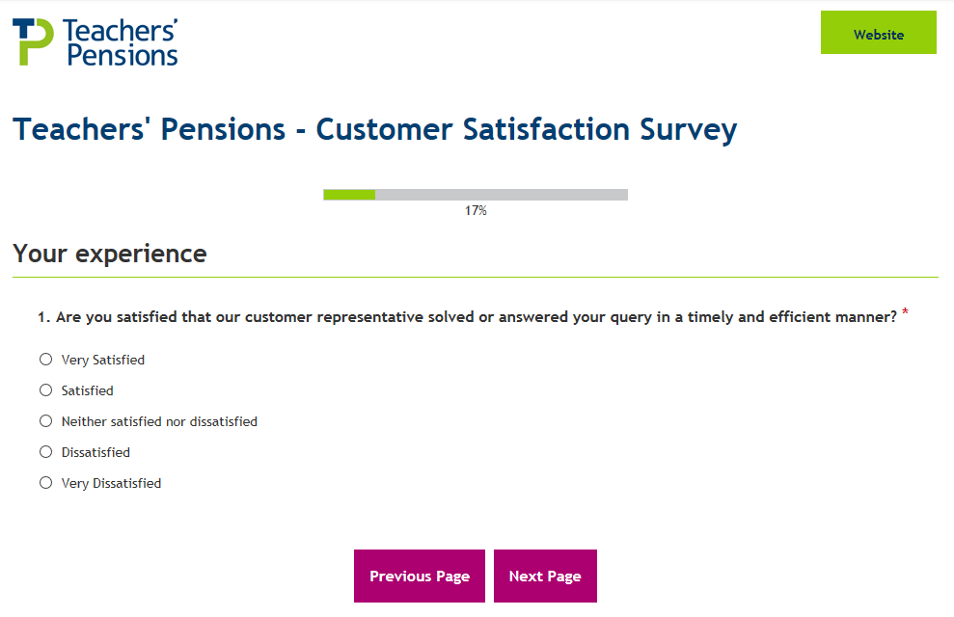
Example survey question

Slide 9
What are you telling us?
“Val was helpful with the query, however she is unhappy that the TR6 has been removed. She now needs to go through a long winded process to get a new Teachers’ Pensions Reference number. She is unable to get a number through MDC as payroll need it before the submission is due (comment was made in Jan).”
“Lisa very good and efficient.”
“Lynne was very helpful and advised what form the member needed to complete.”
“As always the service has been brilliant.”
“First time I've rung and I've spoken to two people this morning and both were very helpful and resolved the issues very quickly.”
“I had to make a 2nd call about an opt out confirm and was told it would be on the portal for me but when I checked it wasn't so hence my call to Lynne this afternoon.”
“The contact details could be clearer on the website, and after the screen after getting the message to say that they have been locked out of the portal should inform members on how to contact us.”

Slide 10
What are our members telling us?
“It seems that when I contact Teachers’ Pensions by email the response doesn't seem to give me an answer that is entirely definite. This time the response is clearer but last time even someone used to reading legal documents could hardly make out the response. This is so worrying when you're trying to make such big decisions over such an important issue as pensions.”
“All very positive. I haven't been in the website for a few weeks and wanted to catch on things. This was quick and easy to do, in part due to the layout of the website.”
“Your service, especially as I am out of the country, has been very easy to use. I am impressed with the security when signing in. Thank you for thinking of the user.”
“I rang the call centre. The information they gave was accurate and enabled a smooth transition from employment to retirement. Thank you.”
“I keep getting a new password and pin from you that don’t work.”
“The people I spoke to did not do what they said they would - they said they would send something out to me but it has not arrived.”
“Service is excellent both professional and friendly. Staff make what could be a difficult and stressful experience stress less. Thank you so much.”
“All communication done online - all very efficient and pensions was paid on date expected. Thank you. Most helpful, understanding and efficient.”

Slide 11
Digital Update

Slide 12
Webchat
Webchat was launched on 5 November 2018 and the trial of the new contact channel is ongoing
15,141 chats have been handled within the trial period with an 81% answer rate, demonstrating the appetite for the contact channel
The average time our members spend ‘chatting’ with us is 7 minutes, asking a wide range of Scheme related topics
At this time we can handle chats in relation to general information with the top 3 categories for contact being Applying for Retirement, Service and Opting In
A new web form has been introduced to handle member specific queries which cannot be answered over chat
The introduction of the channel has also provided reductions in complaints across numerous areas of the business.

Slide 13
Webchat feedback

Slide 14
Website updates June 18 to April 19
My Pension Online – The new dashboard launch
Member status module
Service history module
Nominations module
Tasks module
Contact us for Social Media
Ordering of Employer data centres
New Overseas Declaration web form
Improved responsive design for mobile devices & new navigation
Web chat
New P60 design and layout
New Payslip design and layout
Migration to Azure
Migration to Sitecore 9.0

Slide 15
Employer Portal – UX & Development
The path to a live release:
Employer Persona research
Member Search improvements
Creating Dashboard wireframes from research (Current stage)
Creating the design from the wireframes
Re-test with users
Develop with IT team
Release to live in mid – late 2019.

Slide 16
Web stats 2018 / 2019
Website Visits:
3.2 million in 2016
4.26 million in 2017
4.6 million in 2018
1.8 million in 2019 to date
1.1 million email addresses
875,554
MPO accounts
Benefit Statement
716,196
unique views
3.2m
calculator page views
2.1 million web form completions in 2018
(includes A/C changes)

Slide 17
Social Media stats 2019
Facebook
10,994 likes
(426 comments from January-April 2019)
Twitter
5,739 followers
(2,953 link clicks from January-April 2019)
Instagram
708 followers
(514 likes from
January – April 2019)
LinkedIn
672 followers
(295 engagements from January-April 2019)
YouTube
364 subscribers
(289,332 views)

Slide 18
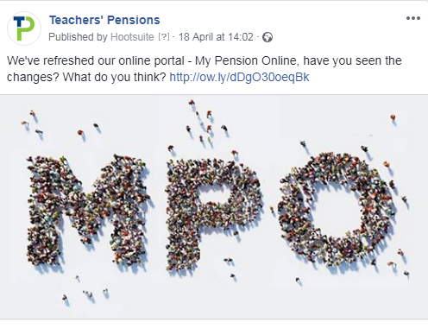
Social Media examples

Slide 19
Operations update

Slide 20
Operations update

Slide 21
GMP
Following the nationwide public service pension exercise to reconcile pension information, we took steps to inform its members from Jan-March of revised pension payments
The exercise commenced on 7 January and was completed by 22 March 2019
Letters went to every member/survivor who were identified in relation to an overpayment and to amend future pension payment
The Department for Education (DfE) wrote off historical overpayments but it has a duty to ensure correct pension payments are made in the future
21,975 members identified with an overpayment as a result of the GMP reconciliation Project
521 calls resulted in a referral to Darlington, 2.3% of the total letters issued
The low overall contact from members following the issue of the communications has demonstrated that the contact of the communication has been understood and appropriately explained. That coupled with the support from the various stakeholders has ensured the success of this Project.

Slide 22
Factors
Following the Scheme Valuation exercise, new factors have been introduced.
There isn’t one ‘effective date’ from which the new factors were implemented, for a couple of reasons:
The change to the discount rate used for public service pension schemes announced in the October 2018 budget meant that the factors for transfers and pension sharing are effective from 29 October 2018
Factors for certain aspects of the Career Average arrangement are effective from when the scheme actuary (GAD) provided them, others are effective from a date decided by the Scheme manager. For these, the impact on the administration of the Scheme and the best, consistent outcome for members was used to determine the effective date.

Slide 23
Factors
GAD will be providing updated guidance and examples later in the year. In the meantime, the latest factors and existing guidance/examples are available on our website.
Other changes not related to factors, such as the increase to the contribution tier salary bands, have been communicated to employers. This information is made available on the updates page of the our website:
teacherspensions.co.uk/members/resources/forms/updates.

Slide 24
Effective date - selected factor types
Factor Type | Effective date for new factors
 | Final Salary | CARE
Cash Equivalent Transfer Value (CETV) | 29 October 2018
Pensioner Cash Equivalents on Divorce | 29 October 2018
Transfer-in (non-Club) | 29 October 2018
Club Transfers (transfers out and in) | 01 April 2019
Early Retirement Factors | 01 March 2019 | 06 December 2018
Late Retirement Factors | 01 March 2019 | GAD Calculator
Inverse Commutation (Conversion of Lump Sum to Pension) | 21 December 2018
Trivial Commutation | 01 March 2019
Capitalisation of Premature Retirement | 21 December 2018
Additional Pension | 01 April 2019
Buyout of Standard Reduction (aka AAB Buy out) | 01 April 2019
Faster Accrual | 01 April 2019

Slide 25
Historic Data Cleanse
A contractual requirement is in place to check member’s records for accuracy to ensure the correct level of benefits are paid upon retirement
Historic Data Cleanse has been introduced to enhance the current Retirement Data Cleanse routine to check member’s records for accuracy before members apply for retirement
The new routine uses the same process as the current Retirement Data Cleanse exercise
Due to the implementation of the Historic Data Cleanse routine queries to employers have increased which has placed additional impact on workloads
We are looking to amend this process so that employers have longer to respond to such queries (the current process will still apply to retirement cases)
Confirmation of the revised process will be cascaded to employers once it has been agreed

Slide 26
Outcome Measures

Slide 27
Engagement & Training update

Slide 28
Stakeholder – who do we engage with?
Stakeholder groups
Payroll Providers
Unions
Employer Groups
Software Suppliers
Focus Groups & User Experience Research
Bespoke workshops related to specific projects (MCR)
Training
Feedback on email campaigns.

Slide 29
Engagement with Deferred members

Slide 30
Training
In 2018 we delivered 37 seminars and 76 webinars with over 1,700 employers registering to take part
Hosted 4 seminars a month across England and Wales and 8 webinars a month
Subjects covered were:
Working with MDC
Introduction to MCR
Introduction to the Scheme
Understanding Auto Enrolment
Getting the best from the Employer Portal
Introduction to MPO.
Engagement Includes start of term training email, news & feature in the Employer Bulletin
Future plans
Member presentations for employers to deliver
MCR (more in depth support).

