Slide 1
Monthly Contributions Reconciliation May 2019

Slide 2
Monthly Contributions Reconciliation
Project Objectives
The main driver for change within Teachers’ Pensions is the improvement of data held within the system through data management strategies as per the Pensions Regulator requirements.
The introduction of Monthly Data Collection (MDC) went some way to achieving these objectives, but further improvements were identified during the life cycle of the MDC project and the Employer Model Review.
The objective of the Monthly Contributions Reconciliation (MCR) project is to implement these identified improvements, which are to:
Utilise MCR to accurately record and reconcile Service and Contribution information on one submission
Simplify the process for submitting Concurrent Service
Simplify the process for recording Automatic and Contractual enrolment
Simplify the process for removing service, where a member has been placed in the wrong scheme or you have been notified late of a member leaving.

Slide 3
Monthly Contributions Reconciliation
MCR Submission
To achieve the objectives, we need to provide a platform for submitting data that will allow us to compare and reconcile the contributions information provided against the service and salary details and the payment made each month.
This will be achieved by creating a new MCR submission template that allows us to collect all the information we require to perform this reconciliation.
The new MCR submission also combines the following independent submissions into a single process:
MDC Service and Salary submission
Monthly Contribution Breakdown submission
Employer Enrolment submission.
Notes:
Read slide

Slide 4
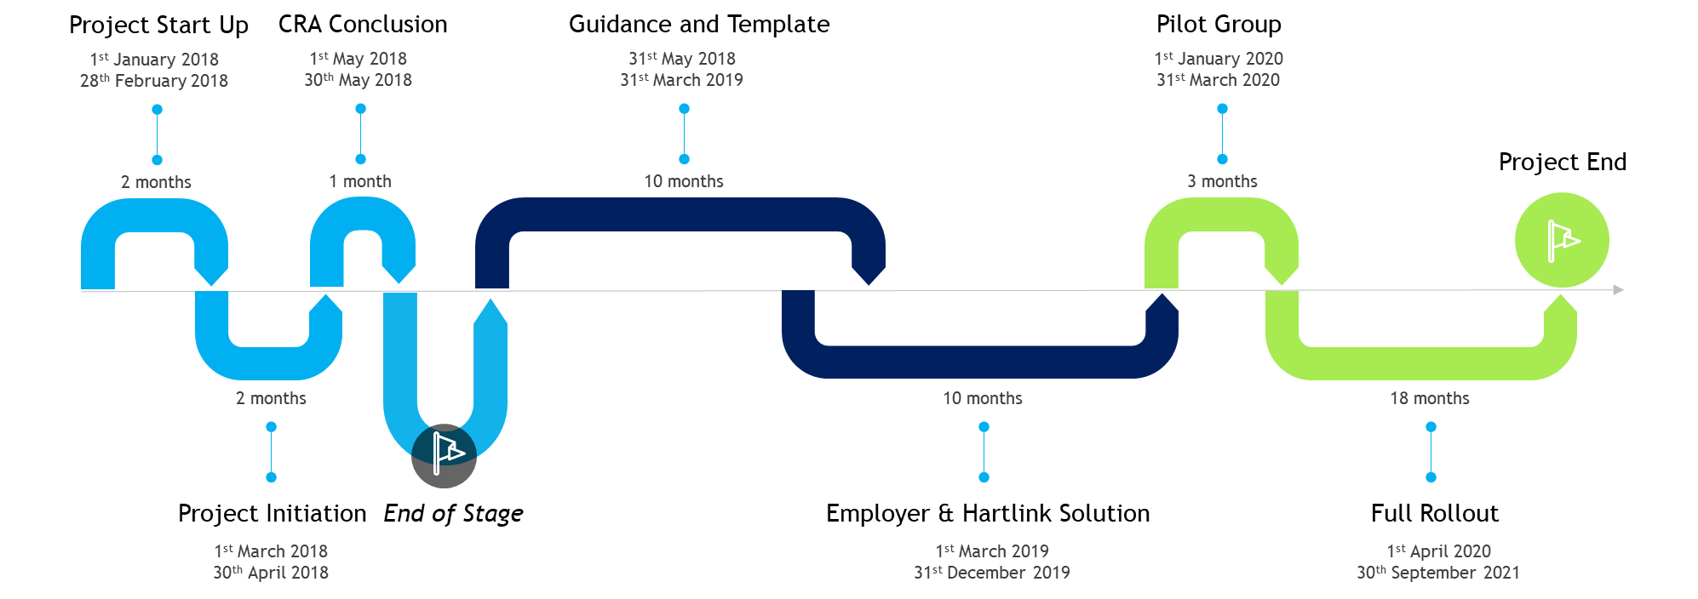
MCR Project Progress
Guidance Notes have now been baselined, which has allowed the project to begin the Business Requirements
Requirements have been split into a number of work streams, which are managed utilising a Work Breakdown Structure
The project is now in the transition between Stage 4 and Stage 5 whereby the project focuses on the requirements and development of the solution.

Slide 5
MCR Workshops
February 2019 saw the conclusion of the final Teachers’ Pensions led MCR workshops
Throughout the last year, we facilitated 16 individual workshops and 3 MCR specific focus groups (not including presentations at various TPAF and LGA events)
The workshops have been pivotal in allowing us to plan a solution, which works for a cross section of employers and providers
Over 75% of member coverage was achieved through engagement with software and payroll providers
Each workshop was conducted in a formal, yet interactive way which remained professional. The feedback from the workshops show they were well received by stakeholders – we consider this the first project success.
1st Workshop | 2nd Workshop | 3rd Workshop
Payroll & Software Non LA LA | Payroll & Software Non LA Non LA LA | Payroll & Software LA LA LA Non-LA Non-LA Non-LA Non-LA/LA
39 Attendees | 61 Attendees | 184 Attendees

Slide 6
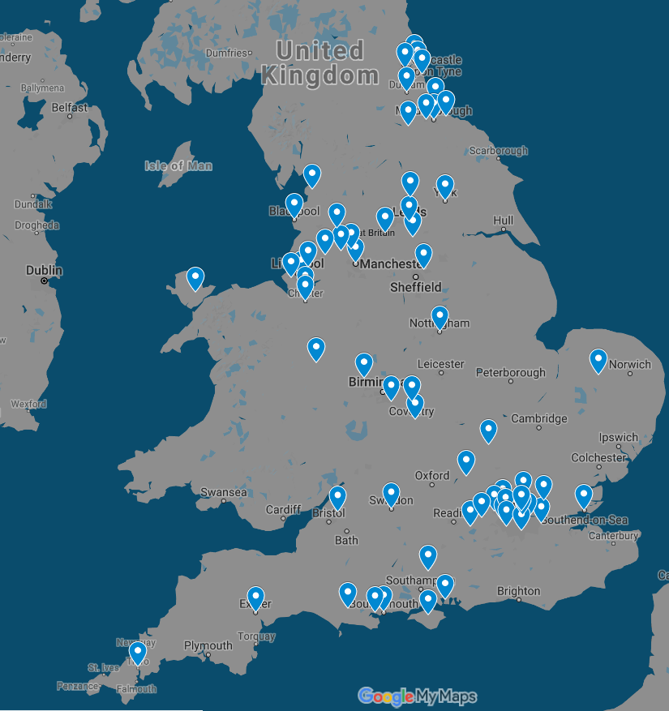
MCR Workshops and Engagement

Slide 7
MCR Guidance and Specification
Three guidance documents have now been completed and approved by stakeholders
These are:
User Guidance – an in-depth document for payroll providers, software providers and employers to develop an automated MCR solution or to collate the required information to use in the MCR template
On-boarding Guidance – a document which explains the on-boarding process for employers and providers and details as to what they’ll expect throughout the transition
MDC Template Guide – a document which provides instruction to those employers who will be completing MCR manually, by using the MCR template directly
The documents can be updated as the project progresses, but as previously outlined, the guidance is comprehensive to avoid retrospective amendments
Completion of the guidance documents is the second project success (following completion of the workshops) and allows the project to begin the development stage.

Slide 8
MCR Engagement
Current Engagement Activities
First MCR email delivered to all segments
Dedicated MCR pages on website
MCR included in employer bulletins and social media activity
Current Training Activities
MCR bespoke webinar started in February
Four webinars per month to be delivered
Currently all full booked – further dates to be announced
Future Engagement Activities
Further MCR email campaigns to signpost key events
MCR specific news stories on website
Future Training Activities
New MCR webinars to cover specific areas of new process
Focus group event

Slide 9
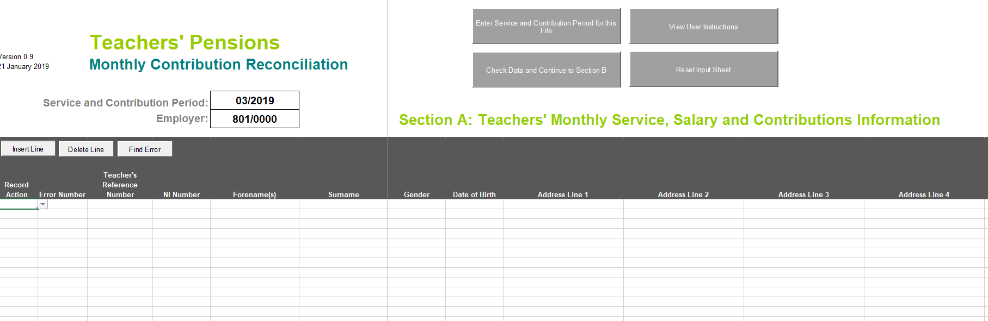
MCR Template
MCR template is now currently at user testing
Upon inputting the necessary service information, the template will automatically calculate the contributions values due and produce a confirmation receipt once uploaded to the Employer Portal
STOP errors and WARNING errors have been developed to highlight areas where the data provided is incorrect or does not conform to the file conventions
User Guidance has also been attached (via a link button)
Import function has also been built to allow providers to review their automatically extracted data.
Notes:
Demonstrate MCR template on screen

Slide 10
MCR Hot Topics
When Paid/When Earned
Different methods of calculating contribution deductions/refunds
‘When Earned’ method only to be used in certain circumstances
Calculating Contribution Deductions based on the ‘When Paid’ method
This method requires you to take the total of the member’s pensionable pay paid within a pay month (excluding any payments relating to overtime and/or arrears relating to back dated pay increase), multiply it by twelve and use this calculated value to determine the contribution percentage (i.e. tier) the member is required to pay in that pay month.
This contribution percentage is then applied to the total pensionable pay paid in the pay month (including any payments relating to overtime and/or arrears relating to backdated pay increase) to determine the deduction.
This will be the default method used within our routines (and generally by payroll software systems) to calculate contribution deductions.

Slide 11
MCR Hot Topics
When Paid/When Earned
Calculating Contribution Deductions/Refund based on the ‘When Earned’ method
This method requires you to determine two values, the ‘What should have been deducted’ value and the ‘What has been deducted’ value. You would then minus the ‘What has been deducted’ value from the ‘What should have been deducted’ value and the result of this sum will leave you with a ‘When Earned’ adjustment. A ‘When Earned’ adjustment can be a positive or negative value.
First time payment (e.g. late notification of joiner)
Determine the ‘What should have been deducted’ value by assessing the payment as though it was being paid when it was earned (or at a specific calculation date if required) and the ‘What has been deducted’ value as zero.
Correction of payment (e.g. refund, underpayment of salary due to employer error)
Determine the ‘What should have been deducted’ value by reassessing the pay month the correction relates to using the up to date pensionable pay information for that period. This reassessment must use the tier and banding rates applicable during the pay month, but using the correct amount of pensionable pay to determine the contribution percentage (i.e. tier) and the new contributions total for the period.
The ‘What has been deducted’ value will be the total amount of contributions that have already been deducted in relation to each period of affected service.

Slide 12
MCR Hot Topics
When Paid/When Earned
The ‘When Earned’ method must be used once you move to MCR for the following types of calculations:
Refund of contributions due to overpaid salary or a retrospective opt out
This would be the case even when other changes occur within the same pay month to the same periods the refund relates (e.g. when paying a backdated pay increase and also adjusting for overpaid salary)
When making a payment to a member (which requires contributions to be deducted) in pay month after the one in which the member left employment.
We’d also recommend the ‘When Earned’ method is used when an error has occurred in the member’s pensionable pay (e.g. pay not received, incorrect amount paid, Etc...) and the correction of this using the standard ‘When Paid’ method will cause the member to pay more contributions than if calculated using the ‘When Earned’ method.
However, using this method to process a correction as described above is at your discretion and is not mandated by the Scheme. We do advocate that if you choose to use this method, that consistency is applied across the employer.

Slide 13
MCR Hot Topics
Role Identifier
This field will be used to uniquely identify an “employment” and the role within an “employment”.
We currently do this on our systems by using the following sting of data:
Teachers’ Pensions Reference number
National Insurance number
Date of Birth
Establishment number
Local Authority number
Role Identifier
This string is limited as a member can have multiple employments or multiple roles within an employment that would be submitted using the same Local Authority Number and Establishment Number (concurrent service).
The Role Identifier (RI) has been introduced to extend this string to allow us to record ‘Concurrent Service’ within the same Local Authority Number and Establishment Number without the need for employers to ‘roll up’ the service into one row of data.

Slide 14
MCR Hot Topics
Role Identifier
The RI will be an employer generated reference that must contain two values separated by a ‘/’ symbol.
The first value will uniquely identify the “employment” and the second number the role within that “employment”.
Employment
Role within Employment
Role Identifier
/
We require both of these values to enable us to correctly validate the contribution calculations for members with different contractual arrangements. From analysis undertaken by us, there are two types of contractual arrangements a member could have:
Type 1 - A separate contract of employment for each job role a member has with an employer
Type 2 - A single contract of employment for all job roles a member has with an employer
As the contractual arrangement is not something we can determine, it’s up to an employer to decide which of these they have in place for their members and generate the RI accordingly.

Slide 15
MCR Hot Topics
Role Identifier
Once the contractual arrangement has been determined for the member, the RI can be created for the different types as follows:
Type 1
The number before the ‘/’ MUST be different for each job role
The number after the ‘/’ can be the same or different for each job role.
Example
Member A has two separate job roles within a school. Each job role is treated as being a separate employment under their contractual arrangement with the school (Type 1).
You would therefore create two RI numbers, with the value before the ‘/’ beings unique for each:
Job Role 1 =
Job Role 2 =
1
1
1/1
/
2
1
2/1
/

Slide 16
MCR Hot Topics
Role Identifier
Type 2
The number before the ‘/’ MUST be the same for each job role
The number after the ‘/’ MUST be different for each job role.
Example
Member B has two separate job roles within a school. Both job roles are treated as being a single employment under their contractual arrangement with the school (Type 2).
You would therefore create two RI numbers, with the value after the ‘/’ being unique for each:
Job Role 1 =
Job Role 2 =
1
1
1/1
/
1
2
1/2
/

Slide 17
Question and Answers
Any Questions?

