Slide 1
TPAF – My Pension Online
May 2019

Slide 2
Overview
Website statistics
Improvements since May 2018
Future plans for My Pension Online
What are the benefits of My Pension Online
Any Questions

Slide 3
Statistics Update

Slide 4
Total Web Visits – 2015 - 2018

Slide 5
Mobile User Growth – Web Visits

Slide 6
Account Holders
Retired Members:
45%
Total:
877,000
(44% of all members)
Deferred Members:
23%
Other Members:
31,507

Slide 7
A walkthrough of improvements

Slide 8
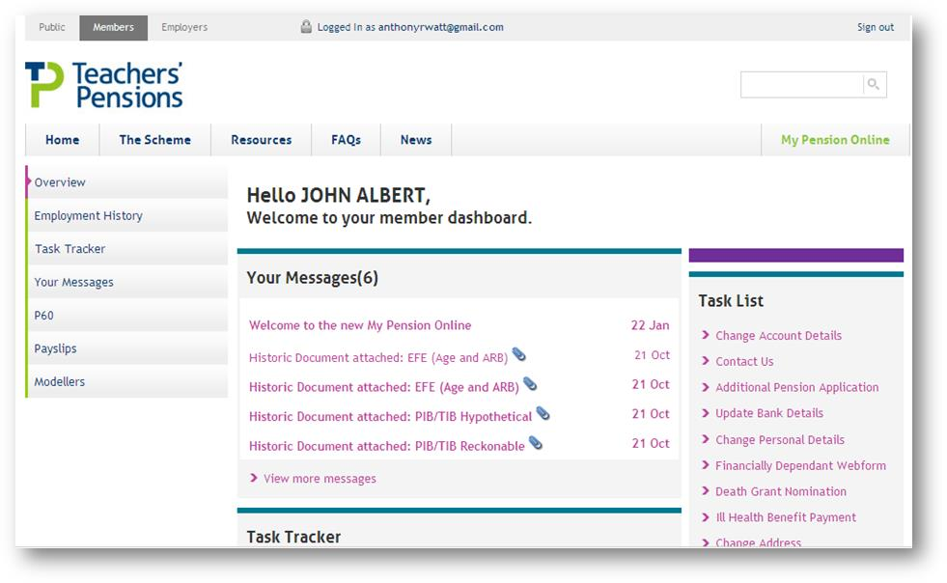
Dashboard Evolution
Pre 2012 |  | December 2012

Slide 9
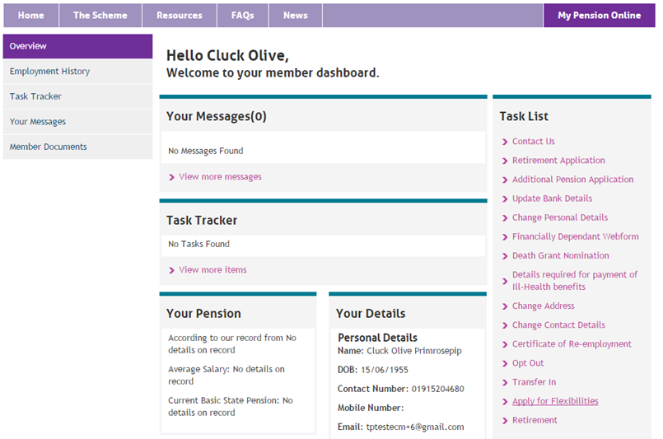
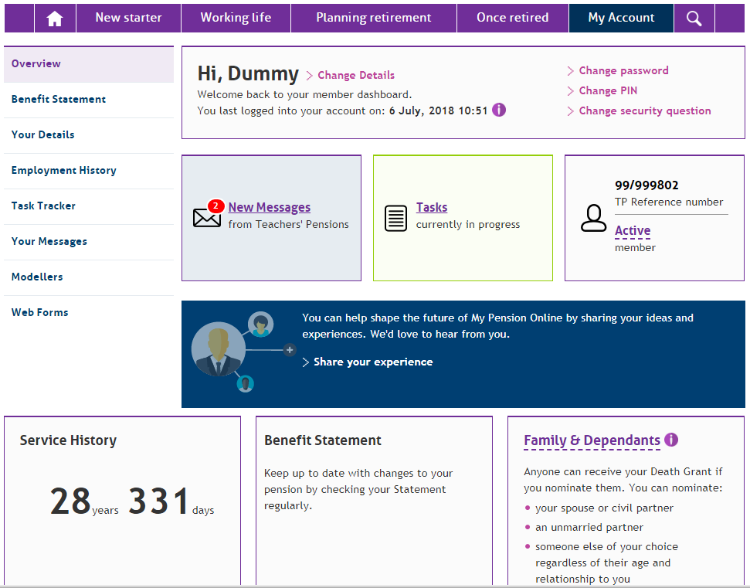
Dashboard Evolution
April 2015 |  | June 2018

Slide 10
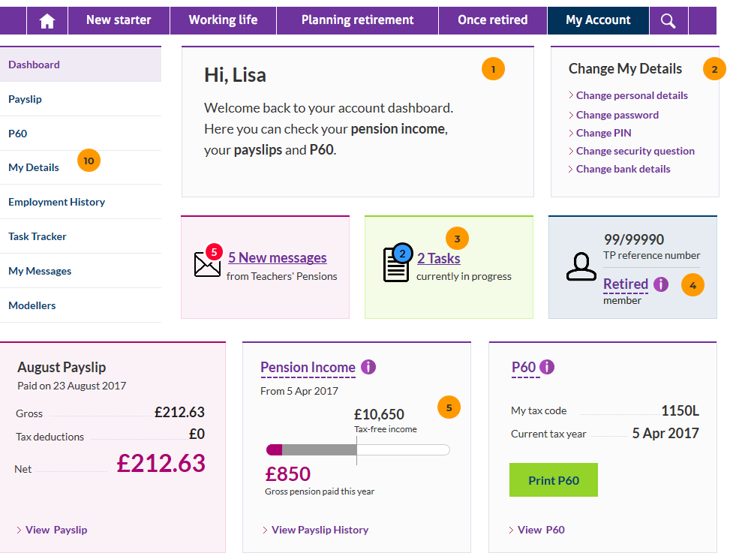
Dashboard Evolution
We’re not done yet
Continuous improvement
Internal testing
Further benefits

Slide 11
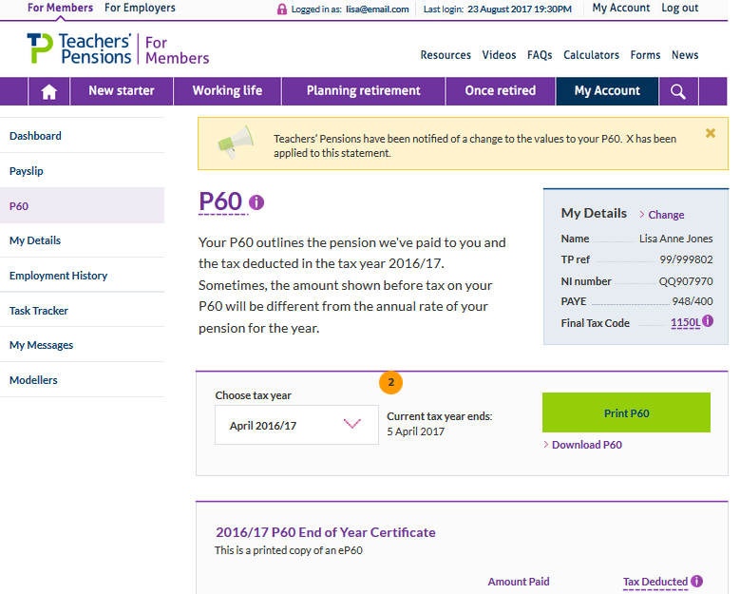
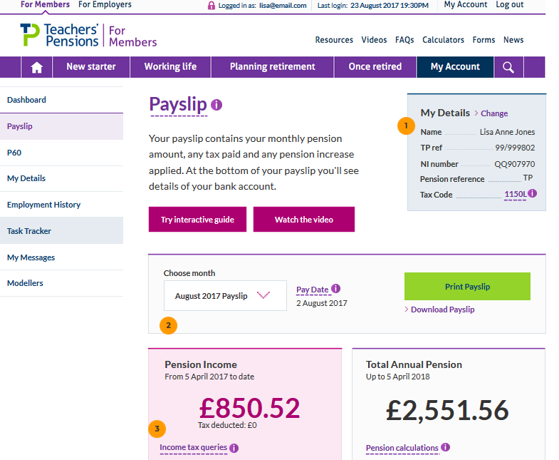
New P60’s and Payslips
Final Steps
HMRC Approved
Business consulted
Tweaks to reduce printer ink
This month / next month

Slide 12
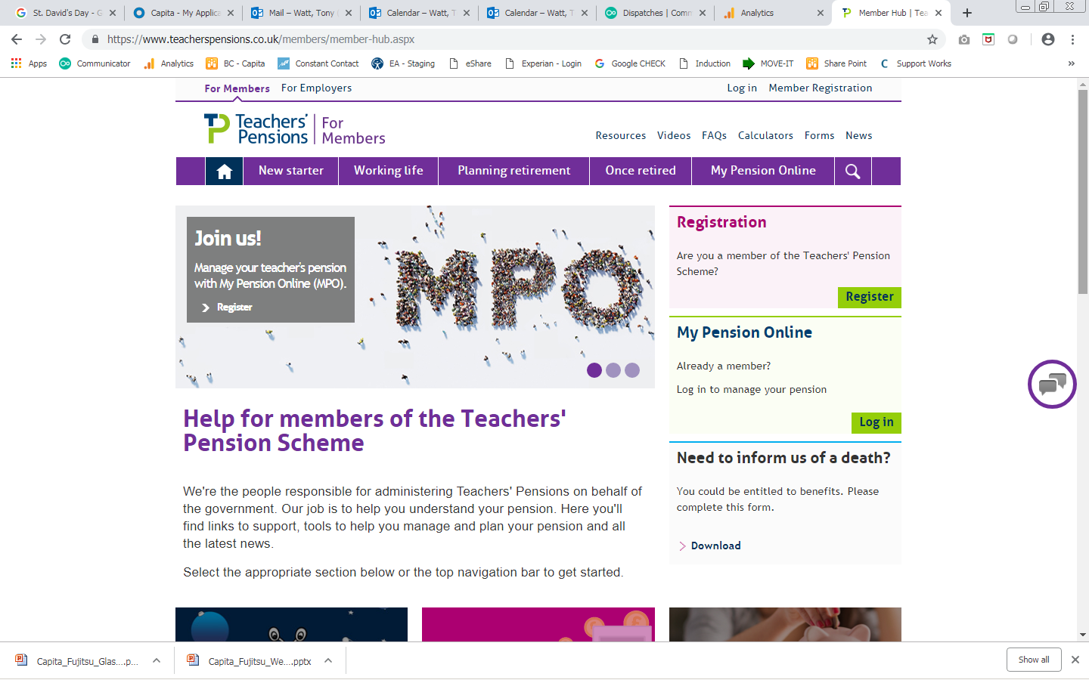
Web chat
Trial launched October 2018
Demand has continued to be high
Top 3
Website queries – 31%
Service queries – 14%
Retirement queries – 8%
Security case for secure Webchat progressing
Exploration of chat bots for quick answers
Interest for an Employer web chat option has been high

Slide 13
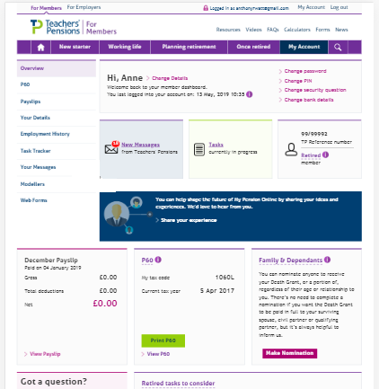
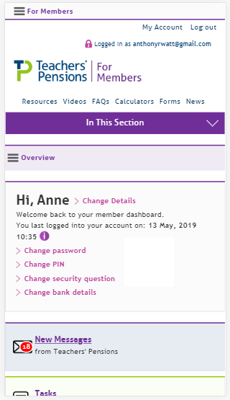
Mobile design
A migration from adaptive to responsive
A better experience across a wider range of devices and screen sizes
Improving accessibility
Improvements will continue to be refined and expanded

Slide 14
Azure & Sitecore v9.1
Benefits from moving to the Azure ‘cloud’ and Sitecore 9.1 CMS:
Speed and reliability – speed improvements have already happened
Machine learning - Personalisation improvements
Improved insight and analytics – better data and understanding
Testing – continuous optimisation
Integrations – with email systems and other channels
Ultimately a better experience for users and easier to make changes for TP

Slide 15
What are the plans for My Pension Online?

Slide 16
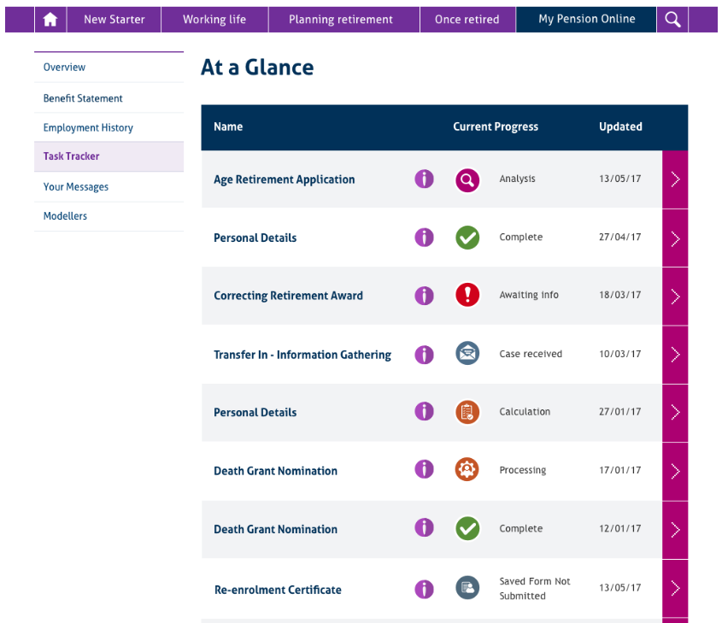
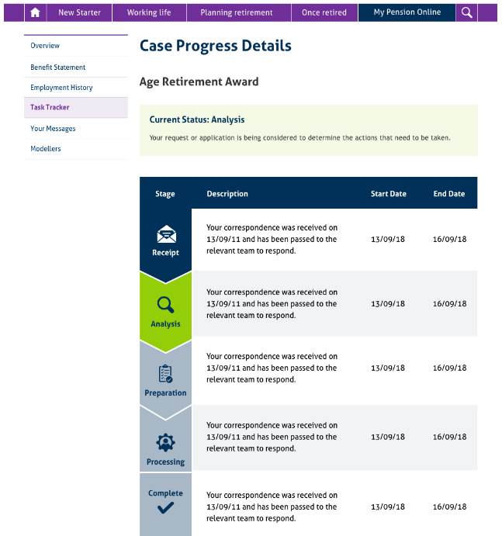
Task Tracker
95% complete
Applying pressure
Aiming for end of Q3
Changes in staffing

Slide 17
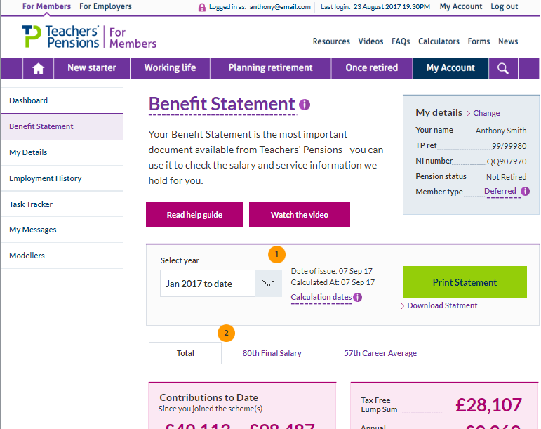
UX Designed with members
of your gross salary will be contributed by your employer towards your package of benefits.

Slide 18
Accessibility
Two audits undertaken
MPO
Non MPO
Screen reading improvements
Page structure and heading concerns – Sitecore 9.1 will help correct / address
PDF accessibility
Cross device suggestions – larger font size than currently used
New carousel that allows user control
Improved contrast ration between colours
MPO report due next month

Slide 19
Digital Personas
Personas and member status are the basis for personalisation across engagement activity
Existing personas:
Developed in 2014
Provide member portal personalisation
Provide pre-login personalisation
Are the core of supporting communications

Slide 20
Digital Personas
Revisiting the 2014 personas with a ‘User Need’ focus to build improved online experiences and communications.
2019 Persona research:
Deep dive into the age group 40-50
determine goals
make sure there are no undiscovered personas
Review 30 to mid-30, to understand the differences in their goals and motivations
How:
30 remote user interviews
4 focus groups (2x NE and 2x SE England)

Slide 21
Log in – Just once per week or less
Stage 1 – completed in 2018
Allowed password to be entered fully
Allowed password retention in browser
Eased the registration criteria
Stage 2 – progressing with Cyber Security
Extend how long you are logged in for to days or even weeks
Device authentication
Reduction in the need for password use
Ability to request a PIN to be sent to a mobile phone

Slide 22
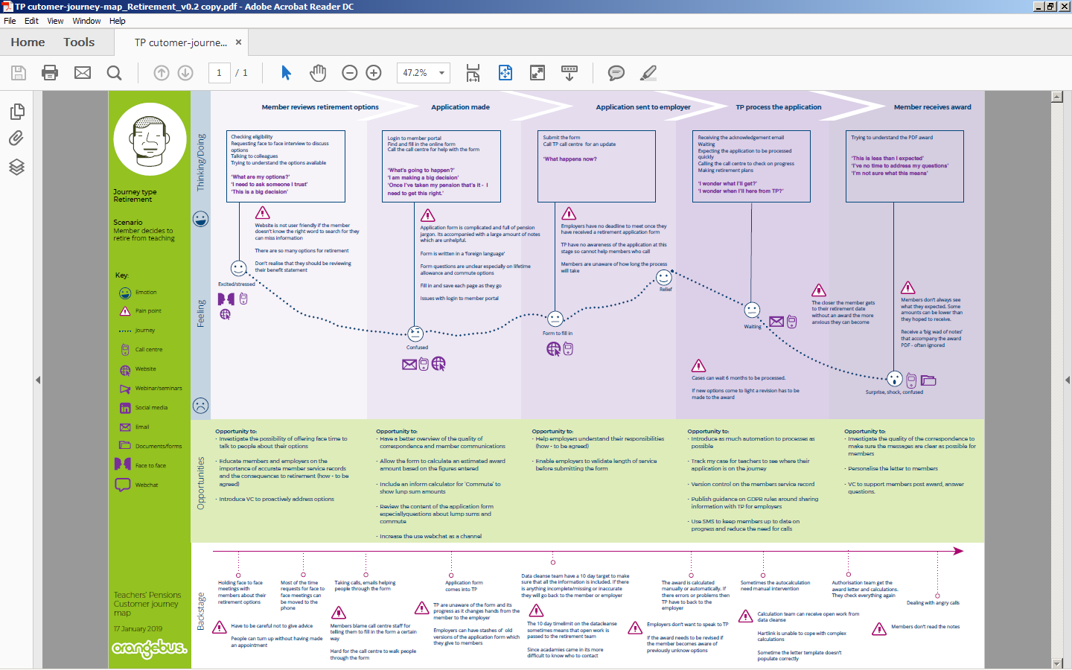

Slide 23
Integrated system
CRM
Hartlink
Web Chat
Email System
Website CMS
Phone
Email
Mail

Slide 24
Mobile App
Depends on members needs
Easy log on - Secure access with Biometrics
Integrated call functions – option for automatic authentication
Push notifications
Integrated messages
On demand P60/Payslip/Benefit Statement (with notifications)
Integrated planning tool – supported by push notifications

Slide 25
What are the benefits of My Pension Online?

Slide 26
Benefits
Members need to call in less often
Time is saved for employers, members and TP
Availability and access to personal pension information 24/7
A secure repository of pension documents, no need to file
Tool for understanding and planning
Improved accuracy of information for all
Easier and more efficient administration
More options for how to interact with TP
Fewer errors completing forms
Offers a more interactive way to understand pensions
Secure messaging and email updates

Slide 27
Benefits for employers
What are the main benefits to you from members having an account?
What could we develop for members to help you further?
What should the future of MPO look like?

Slide 28
Any questions?

