Slide 1

Transitional Protection
Teachers’ Pensions Action Forum

Slide 2
What we will be covering
      McCloud update
      Employer impact
      Valuation
      Cost cap
      Regulation changes
      Independent schools
      Preparation for Transitional Protection
      Communications
      What are we looking at now?

Slide 3
McCloud Update
    Government consultation launched in July 2020
    Two proposals to address the discrimination:
      Deferred Choice Underpin
      Immediate Choice
    Legacy schemes are expected to close 31 March 2022 – all active members who aren’t already in Career Average will be move on 1 April 2022, ending the discrimination
    Following the consultation closure, government will consider the feedback and set out the remedy for schemes to adopt – expected in the New Year
    DfE will consider the Teachers’ Pension Scheme specific changes.

Slide 4
The Scheme & the employer impact
    We’ve established a project team and are assessing the impact across the administration function, liaising with the DfE on policy & technical queries
    Engagement and communications with members and employers are seen as key to a successful implementation, and we’ll build on what worked with the 2015 reform project, involving stakeholder groups in the development of materials
    Other than communications, the impact on employers will be in assisting with a refund of contributions relating to overtime or part-time on top of full-time employment over the course of the remedy period, as transition members are being put back into the legacy (Final Salary) scheme where it wasn’t pensionable. The majority of this work will be from April 2022.

Slide 5
Scheme valuation
    Scheme valuation is underway but in the very early stages
    We’ll keep stakeholders updated on developments throughout the process
    Results aren’t expected to be implemented until April 2023 and will not be known until late 2022/early 2023.

Slide 6
Cost Cap
Re-running the 2016 calculations & review methodology
    Cost cap is a method of sharing scheme costs fairly
    This was paused during the 2016 valuation process because of the uncertainty of the McCloud costs
    Pause lifted in July 2020 and McCloud costs are being factored in
    Results are expected in Spring 2021
    The cost cap mechanism will also be reviewed to see if it’s working as intended.

Slide 7
Regulation changes
    Opposite sex civil partnerships introduced in December 2019 – regulations changed to align pension benefits with those in an opposite sex marriage
    After a recent legal challenge further amendments are required to survivor benefits in the Teachers’ Pension Scheme so that survivor benefits payable to the male spouse or civil partner of a female member will now also be based on pensionable service from April 1972 (or April 1978 if the marriage or civil partnership took place after the member left pensionable service).

Slide 8
Independent Schools
Phased withdrawal consultation
    Government has responded to the consultation on phased withdrawal for independent schools
    The proposal is to allow independent schools to freeze participation so that current members at a school could retain Teachers’ Pension Scheme membership, but it will be closed to new employees
    DfE is now considering the regulation amendments – likely to be put in place in April 2021.

Slide 9
Transitional Protection
What are we doing in preparation?
    Bringing key staff together to work to understand what changes
    Recruitment for new staff
    Mapping out changes to processes
    Developing IT systems to provide the options identified
    Identifying all members who will be affected by the changes
    Working in partnership with the Department for Education
    Staff training
    Starting to process Immediate Detriment cases
    Delivering communication on what we know so far
    Developing communications strategy up to April 2022.

Slide 10
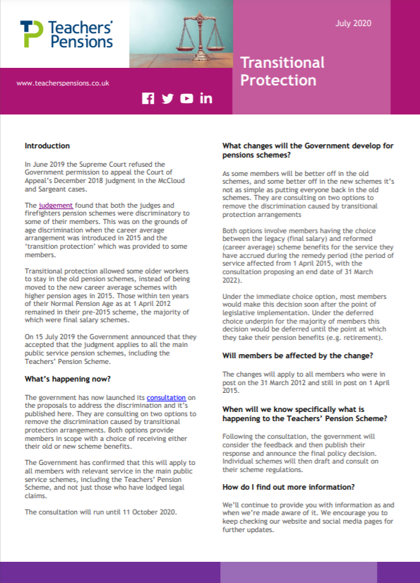
Communication
How have we communicated with you? - website
    News stories
    Bespoke Transitional Protection pages
    FAQs
    Signposting from carousel to key stories
    Factsheet
    Signposting to consultation pages.

Slide 11
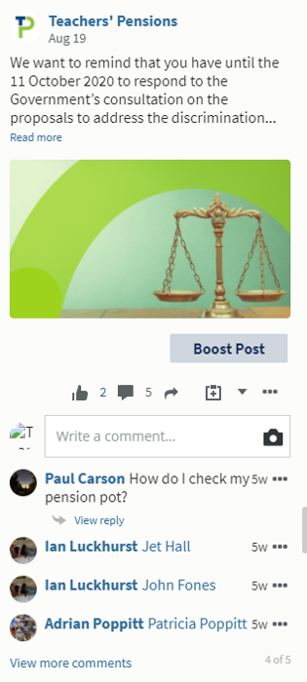
Communication
How have we communicated with you? – Social Media
We’ve posted frequent updates on
Facebook
Instagram
Twitter
LinkedIn.

Slide 12
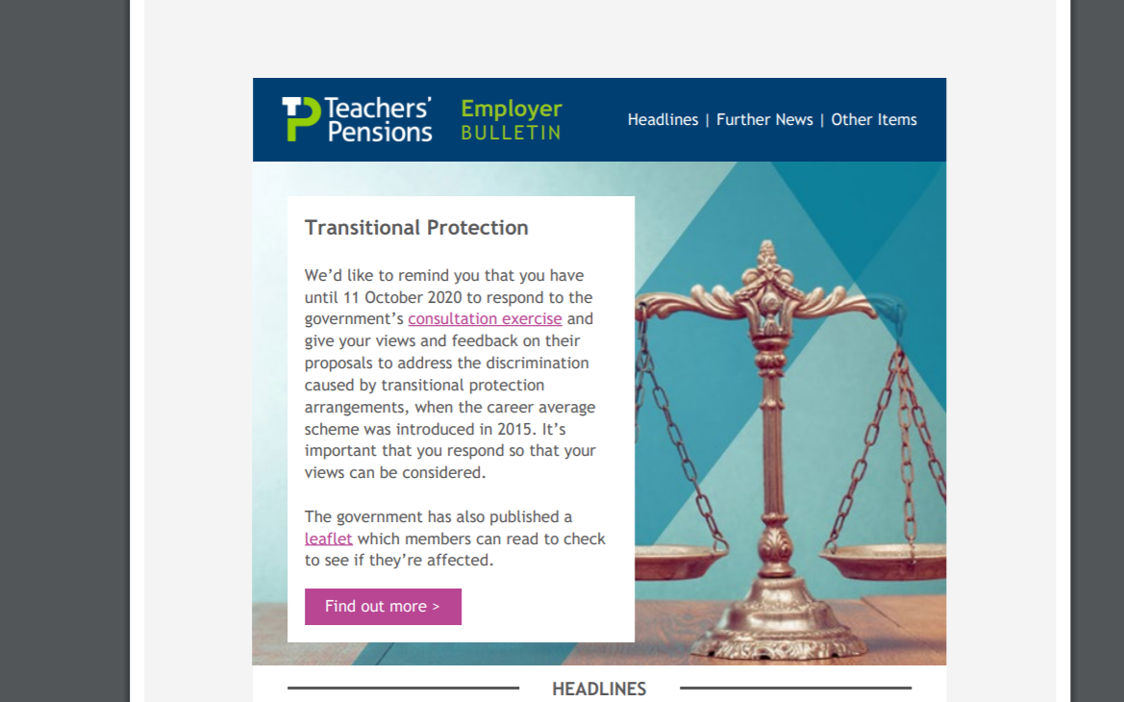
Email communications
Employer bulletins
Payroll provider bulletins
Active member bulletins
Retired member bulletins
Deferred member bulletins
Stakeholder comms
Internal comms.

Slide 13
What are we looking at now?
Cases where we need to communicate prior to April 2022 (known as Immediate Detriment)
How to deliver our communications up to April 2022
Working on the key messages up to April 2022 for stakeholders
Where we can integrate with our general communications
What resources for employer and members
Developing a Member Forum.

Slide 14
Thank you

