Slide 1
Teachers’ Pensions Action Forum October 2024
Transitional Protection resources

Slide 2
Agenda
In today’s session, we’ll be looking at some key tools we’ve created/updated to assist our members to understand Transitional Protection (TrP) and how it affects them.
These are:
Scheme Personalised Calculator
Changes to the Family Benefits page
Changes to the Annual Benefit Statement for TrP affected members
The Flexibilities Calculator.

Slide 3
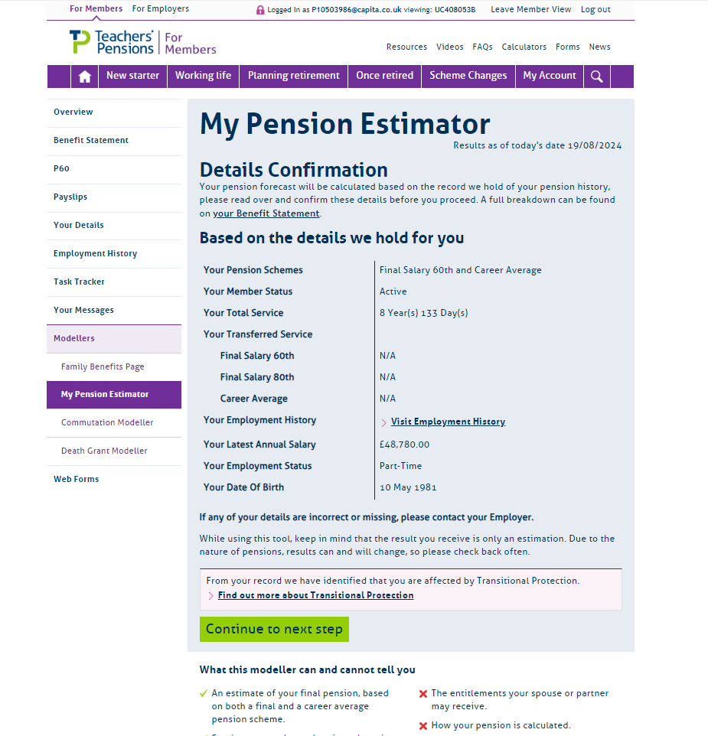
Session 1: Scheme Personalised Calculator
Purpose:
The ‘Scheme Personalised Calculator’ (previously known as the ‘My Pension Estimator’) tool has been created to provide the member with an estimate of what their benefits could be at their preferred retirement age.
The tool is available directly to the member through their MPO account and is located in the ‘Modellers/Personalised Calculators’ section.
Let’s have a look at the tool.

Slide 4
Scheme Personalised Calculator video walkthrough

Slide 5
Any Questions?

Slide 6
Session 2: Family Benefits Page
Purpose:
The ‘Family Benefits Page’ has been enhanced for those members affected by Transitional Protection.
The page is available directly to the member through their MPO account and is located in the ‘Personalised Calculators’ section.
Let’s have a look at the page.

Slide 7
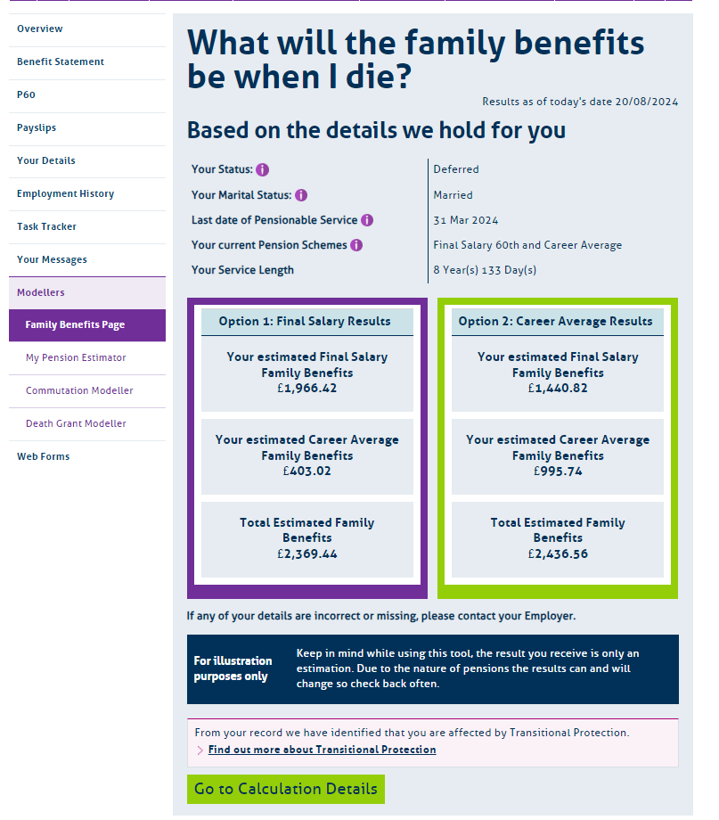
Family Benefits Page (1 of 2)
Any member selecting the ‘Family Benefits Page’ personalised calculator will be provided with a high-level view of their Family Benefit entitlement based on the service and salary information held by the Scheme at the time the request is submitted.
As well as some detail regarding the member’s status, marital status and information relating to their benefits, the member will be presented with a summary of their Family Benefits entitlement under each option.
Option 1 shows these benefits considered under final salary and Option 2 career average.

Slide 8
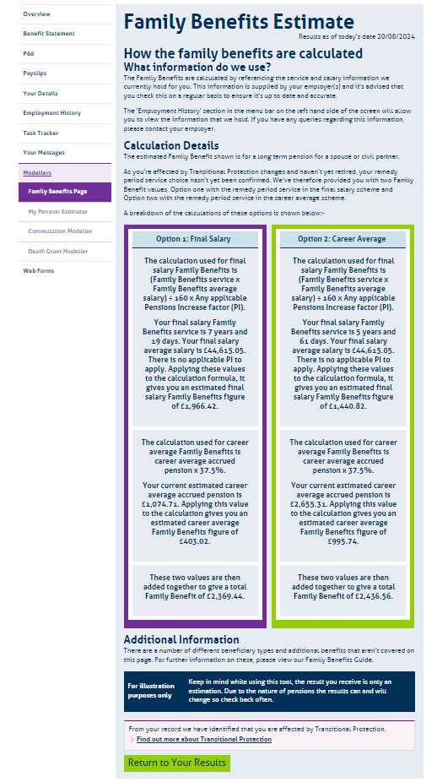
Family Benefits Page (2 of 2)
Selecting the ‘Go to Calculation details’ button at the bottom of the summary tab opens a more detailed view.
This provides the member with a breakdown of how the figures contained in the summary were derived.
While there is no option to print the results, the member can view these in real time as they feel appropriate.

Slide 9
Any Questions?

Slide 10
Session 3: TrP Annual Benefits Changes
Purpose:
The ‘Transitional Protection Remediable Service Annual Benefits Statement’ (also known as the TrP RSABS) has been enhanced for those members affected by Transitional Protection.
The member will be able to access this at any time via their MPO account.
While changes have been made to include additional information specific to members affected by TrP, the look and feel of the document is very similar to the current Annual Benefits Statement.
Let’s have a look at an example document – please note: all figures provided are for illustrative purposes only.

Slide 11
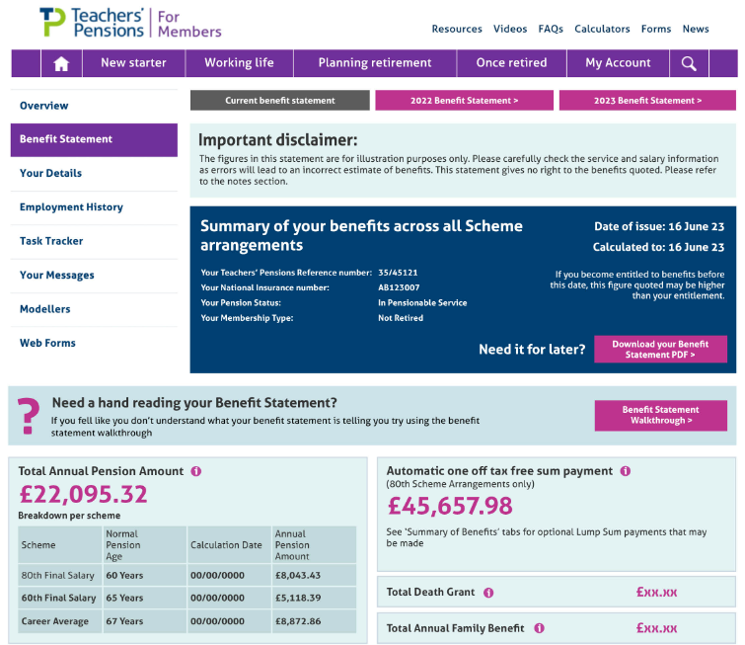
TrP RSABS (1 of 9)
As part of the changes required for an enhanced RSS aimed at those members affected by TrP, we were conscious to use a format that was like their current version (shown here).
The next few slides show the new layout our TrP affected members will see:

Slide 12
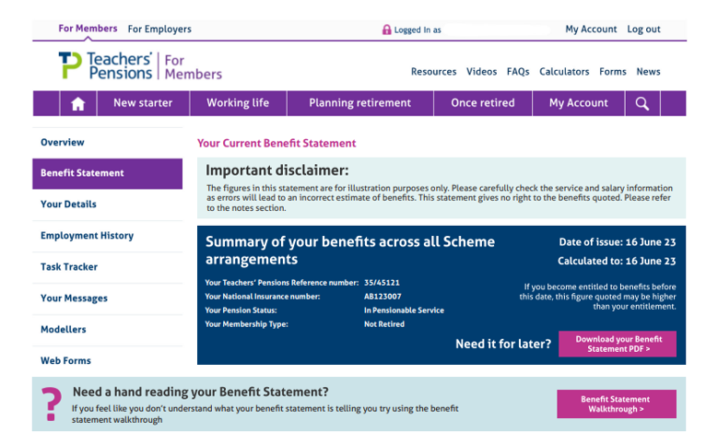
TrP RSABS (2 of 9)
Summary Section
This provides the member with a summary of:
When the statement was created
A summary of their status in the scheme
The ability to download and print the statement (they get a chance to do this at the end of the statement as well)
A walkthrough of the statement if this is needed.

Slide 13
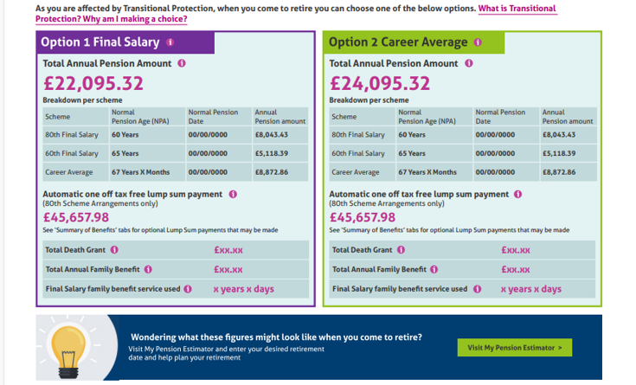
TrP RSABS (3 of 9)
Section 2 – Final salary (Option 1) and career average (Option 2) Total Pension Amounts & Breakdowns
This provides the member with a summary of:
Their total pension amount under each option
Any automatic lump sum entitlement
High-level views of Total Death Grant, Annual Family Benefit Entitlement and the Family Benefit Service used.
There’s also a link to the Pension Estimator to help plan their retirement.

Slide 14
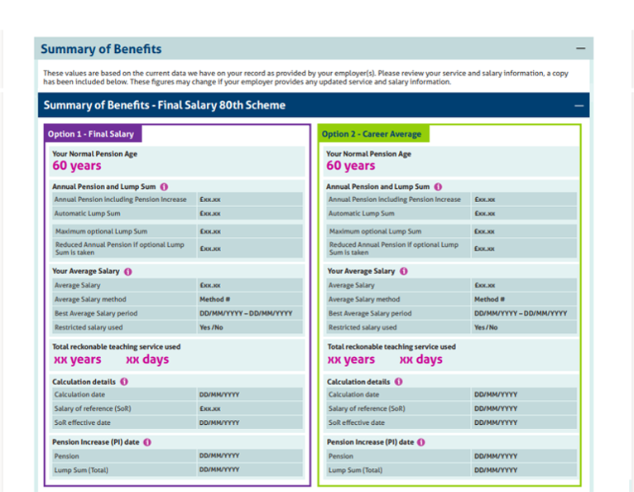
TrP RSABS (4 of 9)
Section 3 – Summary of Benefits
The member will be presented with a breakdown of information relating to each scheme where they have benefits.
If they have service in the 80th, 60th and career average schemes, each scheme will have its own summary.

Slide 15
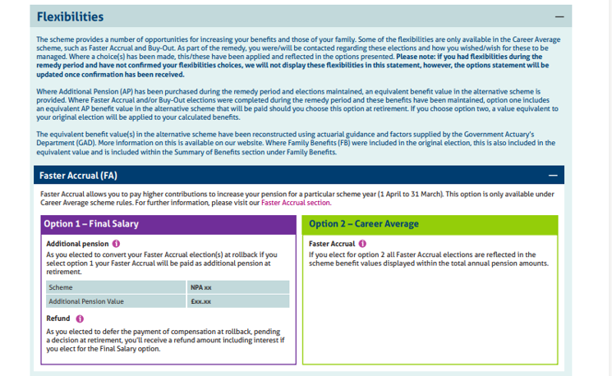
TrP RSABS (5 of 9)
Section 4 – Flexibilities
If the member has any flexibilities, they will be presented with a breakdown of information relating to each flexibility they have.
If they have Faster Accrual, Buy Out and Additional Pension, each flexibility will have its own summary.
If the member doesn’t have a particular flexibility (or no flexibilities at all) the relevant section will not be displayed.

Slide 16
TrP RSABS (6 of 9)
Section 5 – Family Benefits
The entitlement to Family Benefits the member has under each Option will be displayed.
The section relating to Pension on Divorce is dynamic and will only be displayed if the member is a pension debit member.

Slide 17
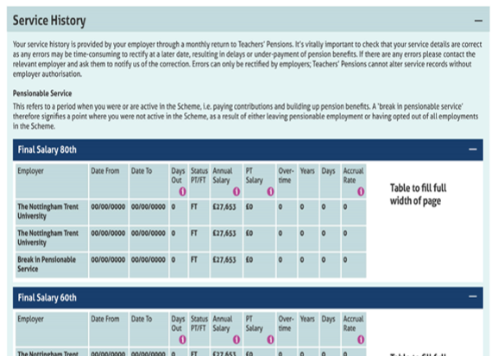
TrP RSABS (7 of 9)
Section 6a – Service History
The member’s service history will be provided.
These sections are also dynamic and will only be displayed if the member has service in a particular scheme.
As with previous versions of the benefits statement, this information should be checked to ensure it is correct throughout their working life.

Slide 18
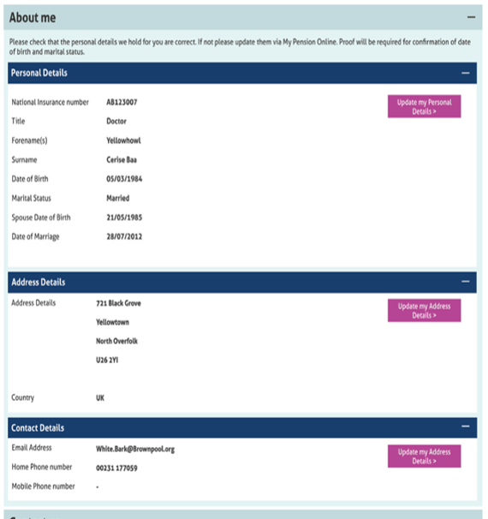
TrP RSABS (8 of 9)
Section 6b – Personal Information
The member’s personal details are provided.
We’ve also included links to allow members to update these details through their MPO account should they need to.

Slide 19
TrP RSABS (9 of 9)
Section 6c – Our Contact Details, Annual Pension Information and Notes
The bottom of the statement contains useful information for the member as well as an option to download the statement as a PDF should they wish to.

Slide 20
Any Questions?

Slide 21
Session 4: Flexibilities Personalised Calculator Changes
Purpose:
The Flexibilities Personalised Calculator has also been enhanced for those members affected by Transitional Protection.
The member will be able to access this tool through their MPO account.
The tool allows members to consider Additional Pension, Faster Accrual and Buy Out.
Let’s have a look at an example of a member considering Additional Pension…

Slide 22
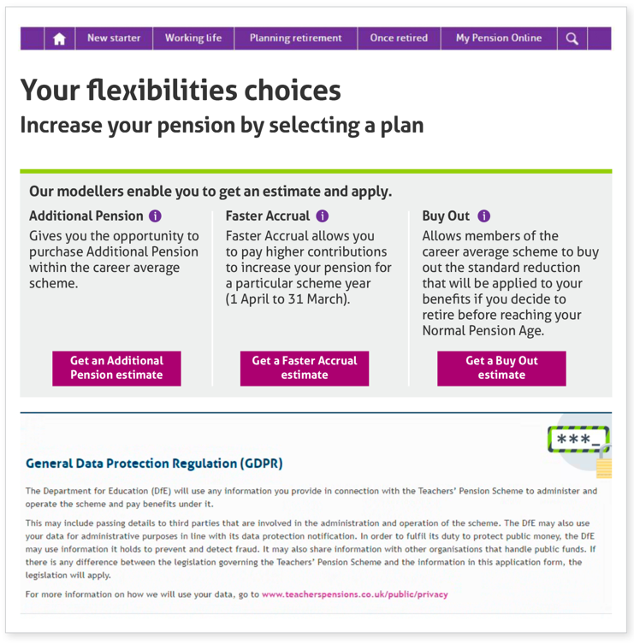
Flexibilities Calculator (1 of 9)
An eligibility checker sits behind the calculator and will only display the flexibilities that the member is entitled to.
If the member wishes to get a flexibility estimate, they should click the relevant button to start the process.
If the member is not eligible for a particular flexibility, the option will be ‘greyed out’ and an explanation as to why provided.

Slide 23
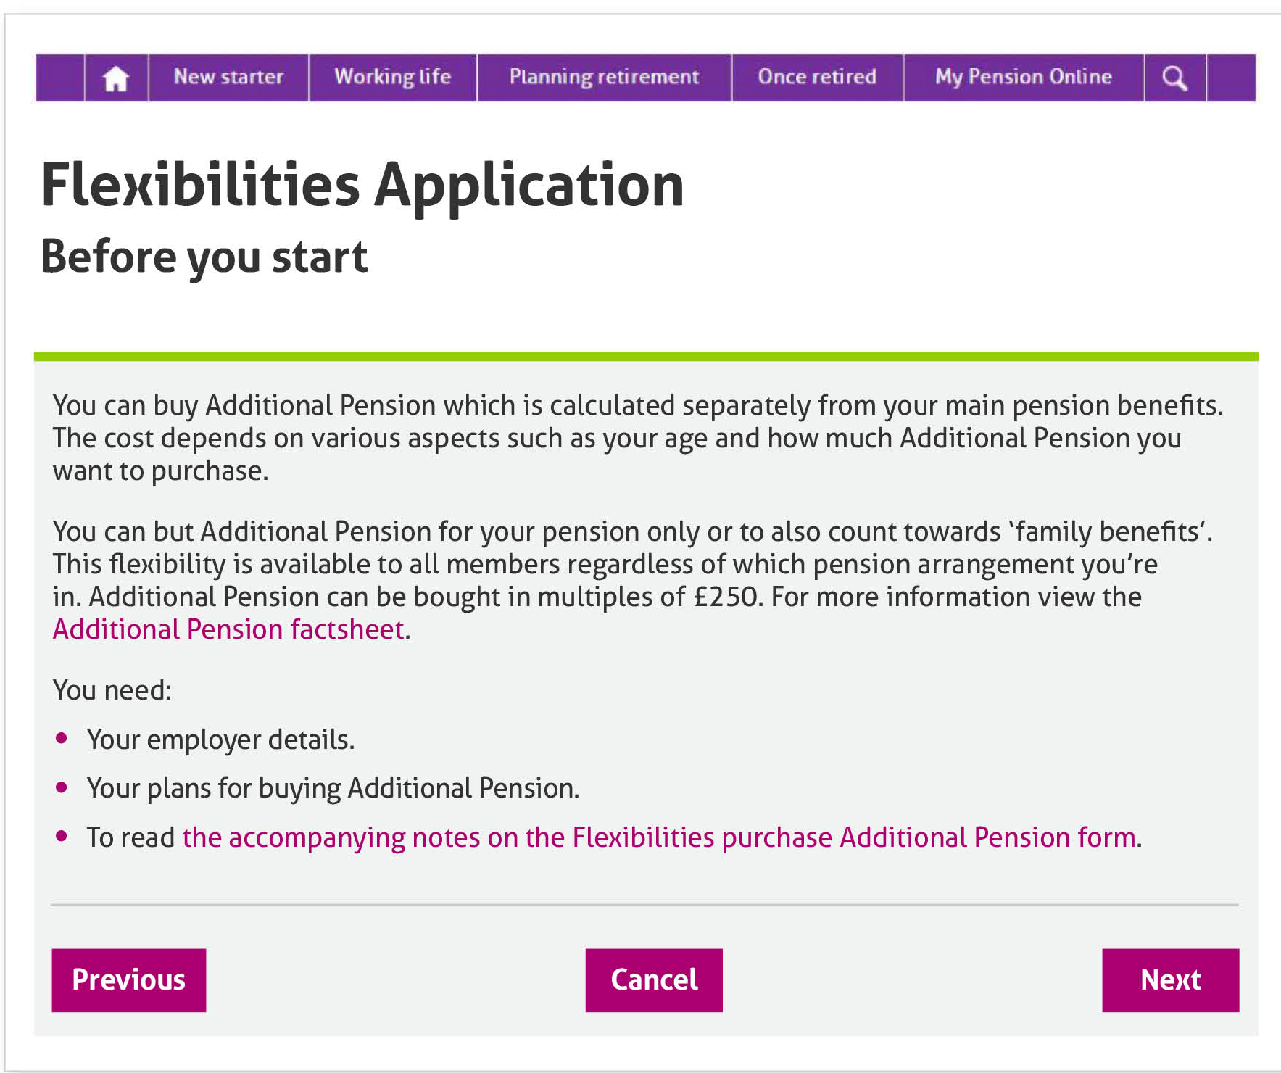
Flexibilities Calculator (2 of 9)
The member will be presented with some key information before they begin the process.
This includes links to relevant additional information that will support their request.

Slide 24
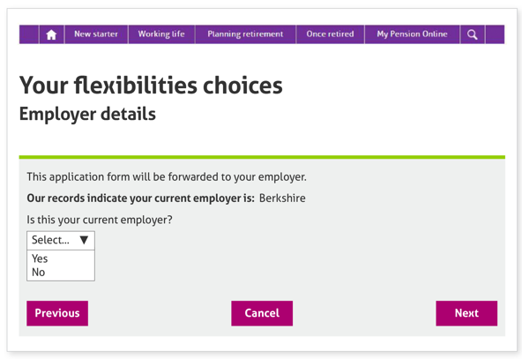
Flexibilities Calculator (3 of 9)
The member will be asked to confirm their current employer.
If the member selects ‘Yes’ they’ll be able to progress to the ‘Purchase details’ screen.
If their current employer is different to the one displayed, the member will select ‘No’ and they’ll be asked to provide more information to help us determine their current employer.

Slide 25
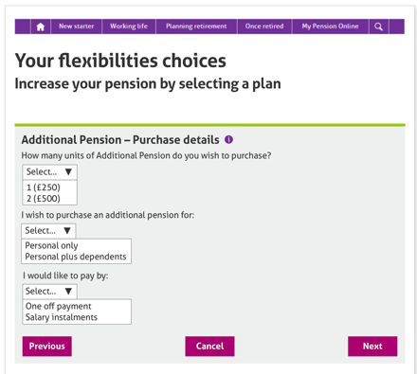
Flexibilities Calculator (4 of 9)
Once we have the employer recorded, the member will be asked to determine:
How many £250 units they’d like to purchase
Whether this is covers them and their dependents
How they’d like to pay for the additional pension (either as a one-off payment or through instalments).

Slide 26
Flexibilities Calculator (5 of 9)
Depending on the method of payment selected, the members will have the purchase options displayed.

Slide 27
Flexibilities Calculator (6 of 9)
If the member chooses to proceed with the Additional Pension purchase, they’ll be presented with a declaration.
This includes links to relevant additional information that will support their request.

Slide 28
Flexibilities Calculator (7 of 9)
If the member chooses to proceed with the Additional Pension purchase, they’ll be presented with a declaration.
This includes links to relevant additional information that will support their request.

Slide 29
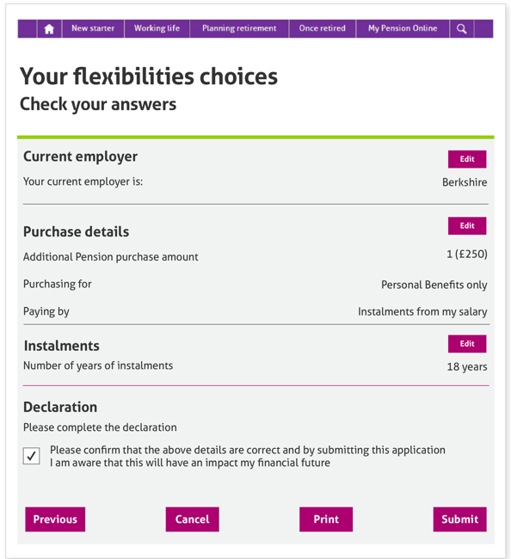
Flexibilities Calculator (8 of 9)
When the declaration is completed, the member is presented with a summary of the details they’ve provided.
The information can be updated should the member choose to.
Once the member is happy with the details, they submit their entry and the member’s part of the process is complete. The member also has the option to print this information if they choose to.

Slide 30
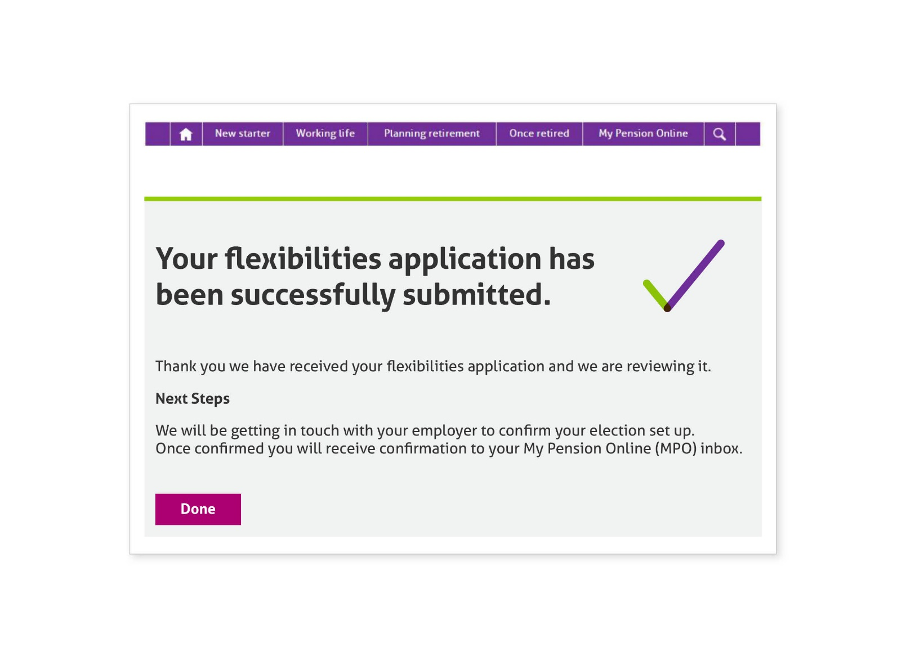
Flexibilities Calculator (9 of 9)
When the form has been submitted the member is presented with a confirmation screen and advised of the next steps.

Slide 31
Any Questions?

Slide 32
Summary
Today’s session was aimed at giving an overview of some key tools we’ve created or updated to assist our members to understand Transitional Protection (TrP) and how it affects them. These were:
Scheme Personalised Calculator
Changes to the Family Benefits page
Changes to the Annual Benefit Statement for TrP affected members
The Flexibilities Calculator.
We hope this has provided you with a high-level view of this collateral to increase your awareness and provide transparency of the changes to help you assist your members with their queries.

Slide 33
Thank you

