Slide 1

Teachers’ Pensions Action Forum June 2024
Employer Toolkit

Slide 2

Today’s session
    Benefits of the Teachers’ Pension Scheme
    Importance of communication to members
    How we communicate already
    Challenges of communication
    Current support
    Employer Toolkit
    Help us, help you.

Slide 3

Benefits of the Scheme
Not impacted by stock markets & investments but grows based on service and salary
Members don’t pay tax on contributions
Employers contribute the equivalent of 23.68% of members’ pay toward the cost
It’s index-linked, so it’s protected against rises in inflation
Ill-health cover and in-service death grant
Offers flexible retirement options.

Slide 4

Importance of communication to members
    Changes to the Scheme
    Updates
    Key actions – view their Benefit Statement
    Transitional Protection
    When they join/leave
    Making life decisions – family, divorce, ill-health
    Understanding their retirement options.

Slide 5


How we communicate
Monthly bulletins
Bespoke emails

Slide 6

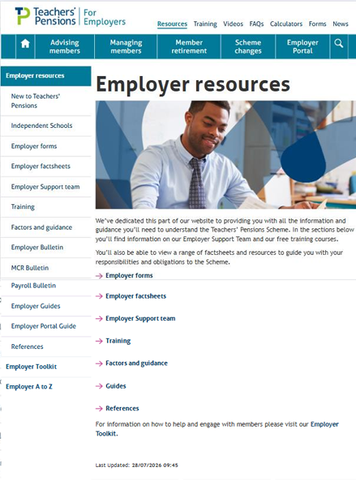

How we communicate
Social
Training
Resources

Slide 7

Challenges of communicating
Data
Member knowing who we are
Methods of communicating
Member goes to the employer for information
Member not engaged (younger audiences).

Slide 8

Employer toolkit
  Provide the resources to help you help your staff
  Developed on themes
  Providing various engagement resources

Slide 9
Poll Question
What type of resources have you seen that we provide?

Slide 10
What we’ve actioned
  Updated main webpage
  Topics:
    Starters and leavers
    My Pension Online
    Flexibilities
    Transitional Protection
  Email templates
    Copyable content – word documents

Slide 11


My Pension Online (MPO)

Slide 12
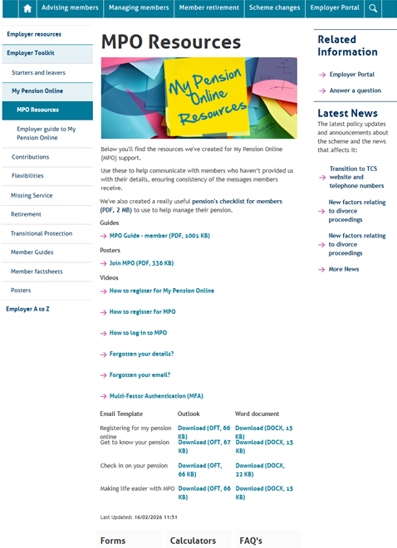
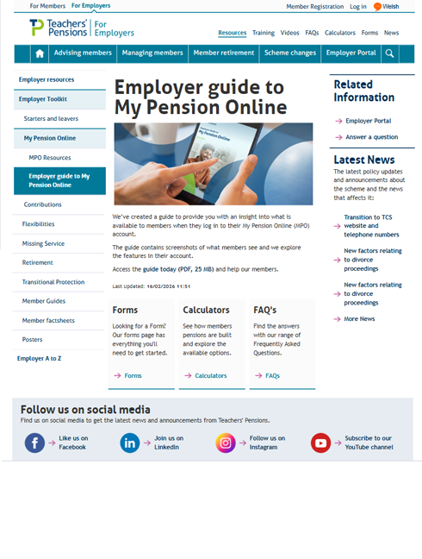
My Pension Online (MPO)

Slide 13

Future topics
Benefit Statement
Family and dependents
Retirement

Slide 14
Question
Are there any other topics you would consider?
      In our previous TPAF session the topic contributions was highlighted by employers. Do you receive questions from members on contributions? If so what type of questions?
Which topics would you prioritise?

Slide 15
Question
What format of resource do you find the easiest to use?

Slide 16
Transitional Protection
Creating a Transitional Protection Bulletin, for employers and members
What type of questions are you asked on Transitional Protection?
What do members struggle with the most?
How can we help?

Slide 17
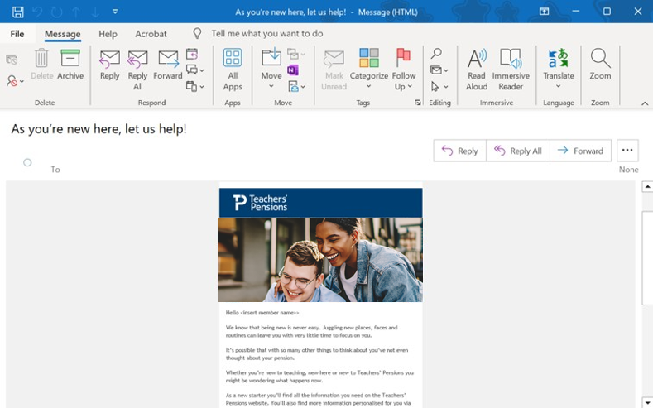
We provide…
    Oft. Templates helpful?
    Do they work effectively?
    Do you know how to use them?
    Other formats?
      Copyable content

Slide 18
Poll Question
What are the key questions asked by members?
How useful do you find our FAQs?
Would it be useful to have a list of top 20 FAQs to answer member queries?
What questions would you include in your top 20?

Slide 19
Help us, help you
  Have you got any ideas for engaging our members?
  What feedback do you receive from members about our communications?

Slide 20
Thank you

