Slide 1
Retirement Process
& Options
TPAF March 2025

Slide 2
Agenda
Overview
Pension arrangements
Retirement options
Retirement process.

Slide 3
Overview
The Teachers’ Pension Scheme is a statutory, unfunded, Defined Benefit occupational pension scheme
The pension is based on the member’s salary and service rather than investments
Employers and members contribute each month on a ‘pay as you go’ basis with contributions received, being used to offset payments to current pensioners.

Slide 4
Pension Arrangements
  Career Average
NPA within the career average scheme will be either State Pension Age or 65, whichever is the later date
1/57th of pensionable earnings each year plus index linking.

Slide 5
Pension Arrangements
Final salary scheme
Based on final average salary, reckonable service and accrual rate
Members joined before 2007
      Normal Pension Age (NPA) is 60
      Accrual rate of 1/80th
      Receive an automatic lump sum
      Members joined after 1 January 2007 and before 1 April 2015
      NPA is 65
      Accrual rate of 1/60th
      No automatic lump sum.

Slide 6
Transitional Protection
Affects members who were in service on or before 31/03/12 and still in service on or after 01/04/15 if they don’t have a break in service of more than five years
Remedy period is 01/04/2015 - 31/03/2022
Members will have the choice between final salary and career average scheme benefits for the period of service affected
Members make the decision at the point at which they take their benefits
All active members are in the career average scheme from 1 April 2022.

Slide 7
Pension Calculations
Pension
Final Salary
Final Salary
Career Average
Normal Pension Age
60
65
In line with state pension
Pension calculation
Final average salary/80 x reckonable service
Final average salary/60 x reckonable service
1/57th of pensionable earnings each year index linked
Automatic lump sum
3 x pension
None, can convert up to 25% of your total benefits to lump sum
None, can convert up to 25% of your total benefits to lump sum

Slide 8
Normal Age Retirement
Member will be eligible for full retirement benefits with no reduction
Based on service and salary
Payable at Normal Pension Age
If benefits are payable in both schemes, the member has options on what to do with their benefits.

Slide 9
Early Retirement
Actuarially Adjusted Benefits (AAB)
It can be taken from age 55
From 06/04/2028 minimum age will be 57
Member’s pension is reduced for life
The member’s pension is index linked each April
The younger the member is when they retire, the greater the reduction
If they take early final salary retirement, they must take career average benefits at the same time
Early reduction factors are used to calculate pension.

Slide 10
Phased Retirement
  Phased retirement is where a member is paid a proportion of their retirement benefits
  Members can take phased retirement from aged 55
  They could take up to 75% of their total benefits before retirement
  Their salary would need to reduce by at least 20% for at least 12 months
  They must have your consent
  They need to apply within three months of the reduction in salary
  They can make three Phased Retirement applications (but only 2 before age 60)
  There is a penalty for exceeding 80% of their previous salary, and their pension will stop.

Slide 11
Additional Service After Retirement (ASAR)
If a member comes back into service after claiming retirement benefits, they’ll be contractually enrolled back into the Scheme
In order to qualify for a second pension, they must complete at least one year of pensionable service
If they do less than this, they would be entitled to an Annuity.

Slide 12
Ill-health Retirement
Ill-health Retirement benefits may be paid if a member has to retire before their Normal Pension Age (NPA)
This can happen when they’re permanently incapable of teaching due to illness or injury
Certain criteria have to be satisfied before a person becomes entitled to benefits.

Slide 13
Serious Ill-health commutation
Pension can be paid as a one-off lump sum
This is approximately five times the initial pension
Member needs to request serious Ill-health commutation when completing application form
If member has more than one year service but less than two qualifying years, they can receive a short service Ill-health grant.

Slide 14
Premature Retirement
Premature Retirement is at your discretion
It can only be taken on the grounds of redundancy or efficiency
The member must be over 55
The member receives an unreduced pension
You’ll make up the reduction
The member will take Retirement in all arrangements at the same time.

Slide 15
Retirement process
Start process 6 months before retirement date
All application forms available on our website as PDF documents
Age and Actuarially Adjusted benefits can be done online through ‘My Pension Online’
If impacted by Transitional Protection, a Remediable Service Statement (RSS) which shows the different calculations will be sent by us
Member completes a choice form confirming their decision
We cannot proceed until we receive this form.

Slide 16
Member Journey
Retirement Form
Retired
Employer Completion & TP Processing
Choices Form
Email to member & Secure message
RS Statement

Slide 17
Retirement Process – Data Cleanse
When a member’s application is received, their record is checked and wherever there appears to be gaps in service or fluctuations in salary, we will contact the relevant employer and ask them to confirm the correct information.
Receiving the response from the Employer will allow us to issue the RSS to the member for them to review and make their Choice
If we don’t receive a response from the Employer within the timescale required, this will delay the Transitional Protection process for the member

Slide 18
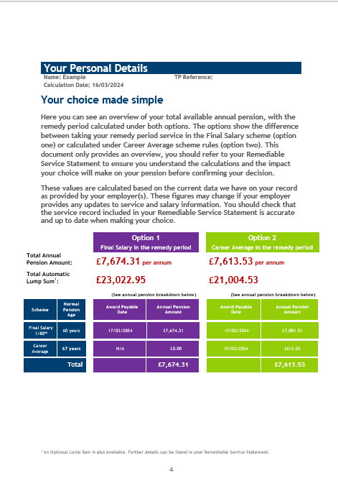
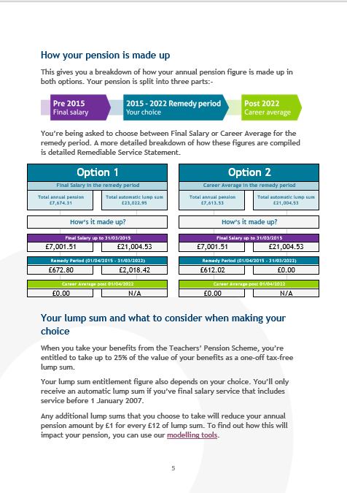
Light choice

Slide 19
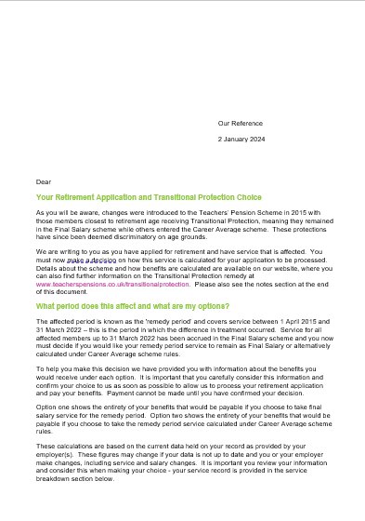
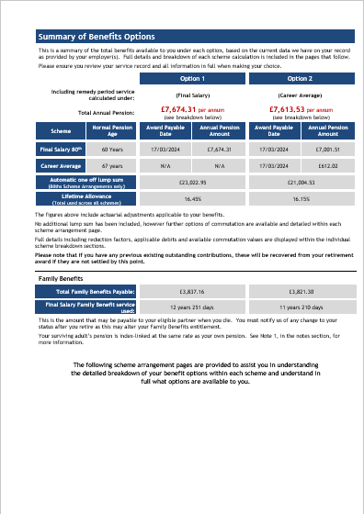
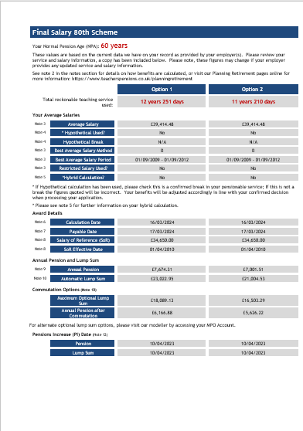
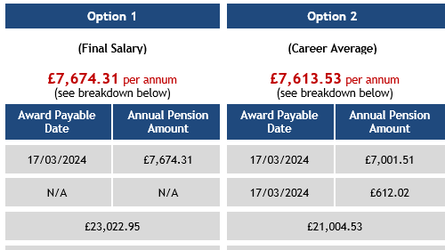
Detailed

Slide 20
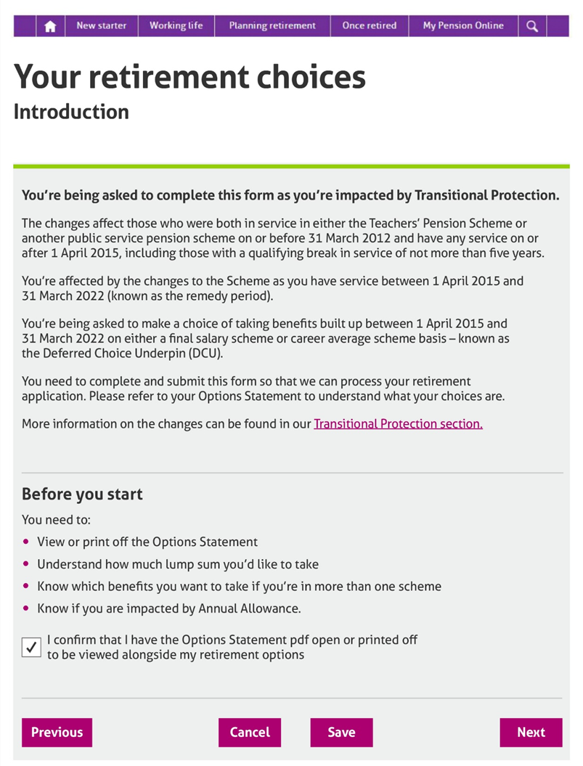
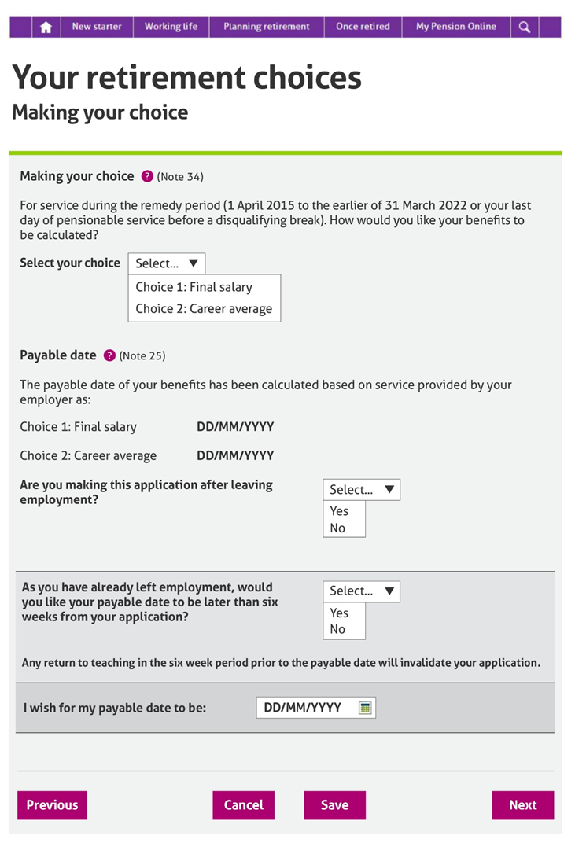
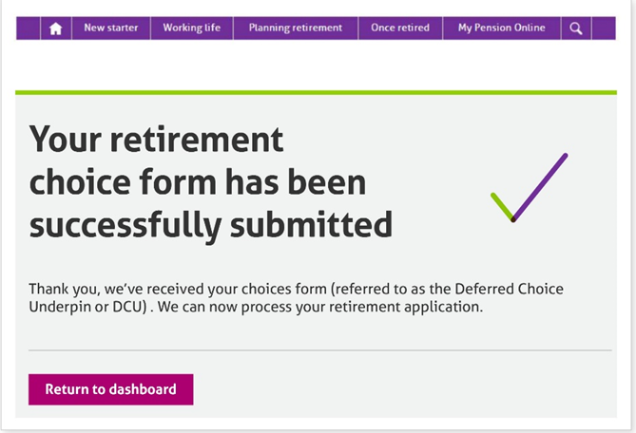
Options

Slide 21
Summary – Key Points
Variety of retirement options available to members
Age and AAB retirement can be done online – all forms are available as PDF documents
Start retirement application 6 months in advance – member initiates process
Ensure employer part of the application is completed in a timely manner
Encourage members to sign up to My Pension Online.

Slide 22





Contact Us
Visit us at: www.teacherspensions.co.uk
Employer helpline: 0345 300 3756
Monday – Friday, 8.30am – 6pm
Employer Secure Messaging
Useful Resources
Useful Videos
Follow us on Social Media
X (Formerly Twitter)
Facebook
Instagram
LinkedIn
YouTube

Slide 23
Thank You

