Slide 1
Teachers’ Pensions Action Forum June 2023
Retirement Process

Slide 2
Agenda
Pension arrangements
Retirement options
Retirement process.

Slide 3
What pension does the Scheme provide?
Career average - (Benefits are based on earnings)
The Normal Pension age (NPA) within the career average scheme will be either State Pension Age or 65, whichever is the later date.
Final salary – split into two sections (Benefits are based on length of service, best final average salary, and accrual rate)
If they joined before 1 January 2007 and they don’t have a disqualifying break – Normal Pension Age (NPA) will be 60
If they joined on or after 1 January 2007 – NPA will be 65.
From April 2022 all members now accrue pension under the career average scheme.
Many members will have ‘mixed service’, therefore where this is applicable, separate calculations will be completed for the pension accrued in the relevant scheme.

Slide 4
Career average scheme
Benefits that fall within the career average scheme are based on 1/57th of pensionable earnings each year (including overtime). The cumulative accrued pension is revalued each year based on whether a member is active or deferred;
Active member – indexation* + 1.6%
Deferred member – in line with annual Pensions Increase.
* This is based on a Treasury Order but is expected to match the rate of CPI in the preceding September.

Slide 5
Final salary scheme
If a member has pension accrual within the final salary scheme then their benefits will be based upon their final average salary and their reckonable service and accrual rate.
If they joined the scheme before 2007
Normal retirement age of 60
An accrual rate of 1/80th for each year of reckonable service
And receive an automatic lump sum of 3/80th for each year of reckonable service.
If they joined the scheme on or after 1 January 2007 and before 1 April 2015
NPA of 65
An accrual rate of 1/60th for each year of Reckonable service
No automatic lump sum (however, they can convert part of their pension to receive a lump sum).

Slide 6
Retirement Options
Age Retirement
Actuarially Adjusted Benefits
Phased Retirement
Ill-health
Additional Service After Retirement
More details can be found on our website.
Notes:
Put in retirement summary slide

Slide 7
Transitional Protection
The remedy will only apply to members who were in post on 31 March 2012 and were either protected or transitioned into the career average scheme on 1 April 2015
Remedy period is 01/04/2015 - 31/03/2022
Members will have the choice between the final salary and career average scheme benefits for the period of service affected
Members make the decision at the point at which they take their benefits
All active members will be placed in the career average (reformed) scheme from 1 April 2022.
Notes:
Change wording

Slide 8
The Digital Engagement Elements
Retirement Form
Benefit Statement
Choices Form(s)
Member Dashboard Module
Enhanced flexibility tools
Decision Tree
RSS Statement(s)
Scheme Modeller
Scheme Calculator
Website Content
Notes:
Linked developments and content
Consistent presentation
Complimentary research and design

Slide 9
Retirement process
Member completes retirement form online
At point of submission, Hartlink identifies service sits within Transitional Protection, non TrP members will follow BAU process
Member receives an email to say message in the MPO inbox to ask them to make their choice
Member logs in and click on secure message in inbox about their options.

Slide 10
Retirement process
Member opens message and receives content covering
Why they are receiving this email as part of their retirement application
Why they have to make a choice as part of their application
What they have to complete
Secure attachment to the light touch options statement (PDF)
Secure attachment to the detailed options statement (PDF)
Link to the options form (contained in secure attachments and in box message)
Member completes their options form & receives confirmation of receipt
If member does not complete the options form after a period of time, reminder process triggered.
Member receives their award papers.

Slide 11
Member Journey
Retirement Form
Retired
Employer Completion & TP Processing
Choices Form
Email to member & Secure message
Options Statements

Slide 12
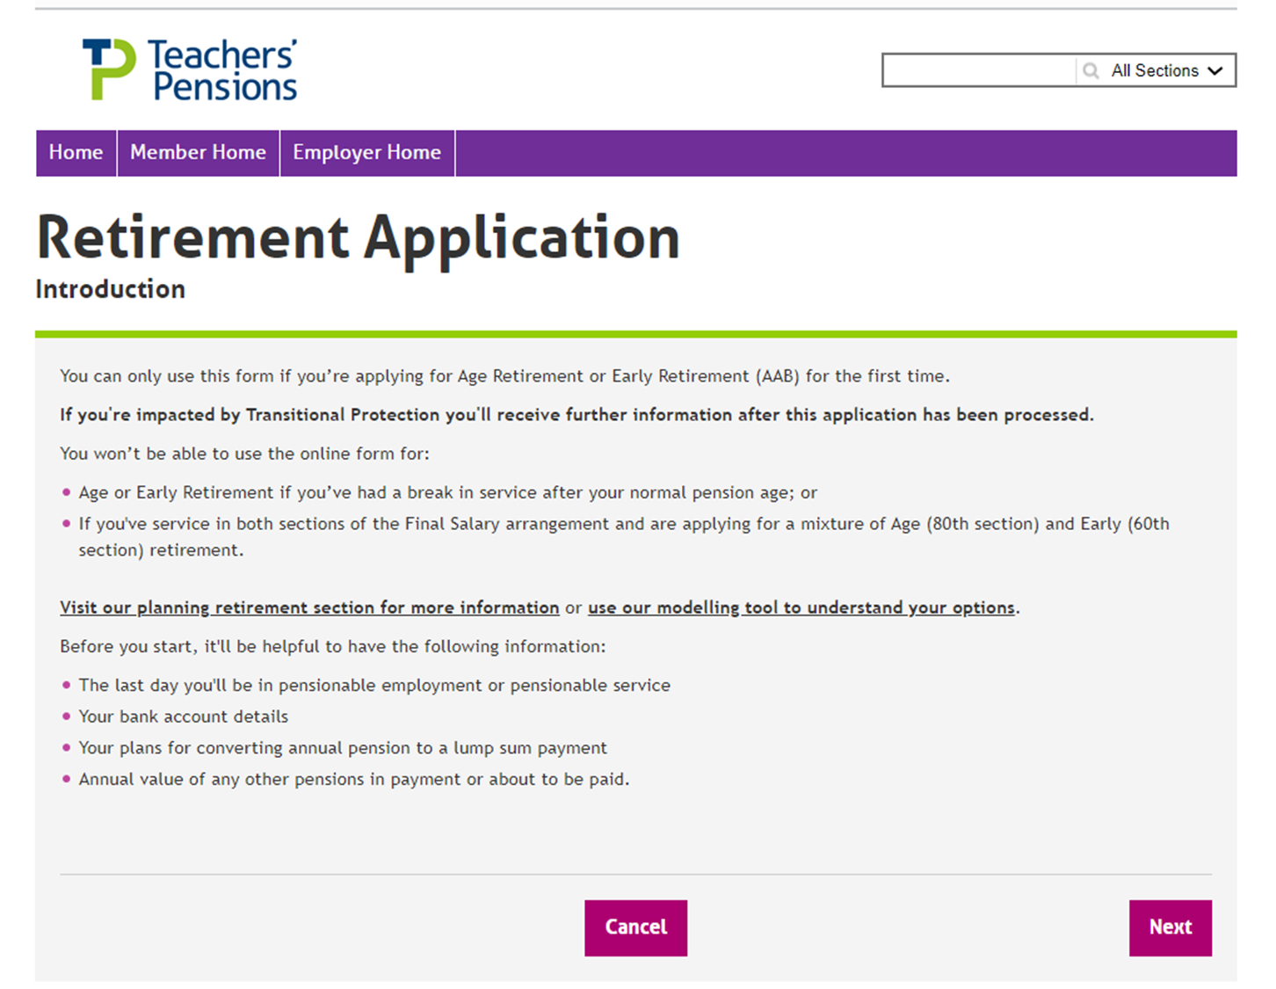
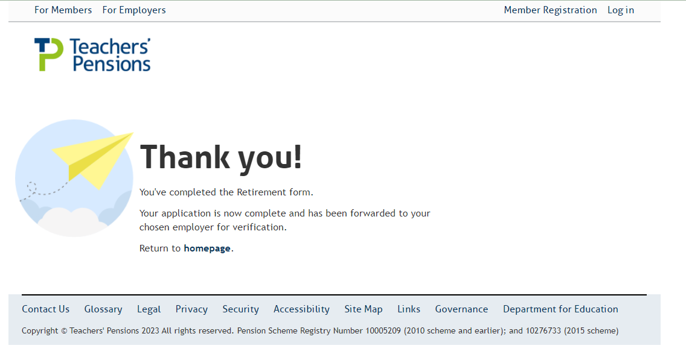
Retirement Form
You’ve submitted the Retirement form. You can use our Task Tracker to view progress.
If you’re impacted by Transitional Protection you will be contacted after this application has been processed.

Slide 13
Retirement process
Employer receives retirement
Checks and sends back to Teachers’ Pensions
Teachers’ Pensions verifies information
Choices email is sent

Slide 14
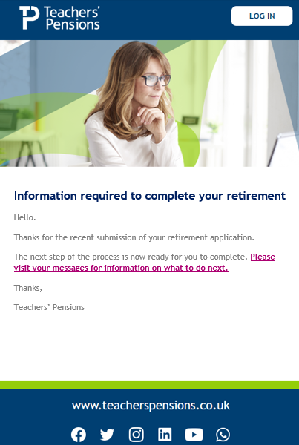
Email

Slide 15
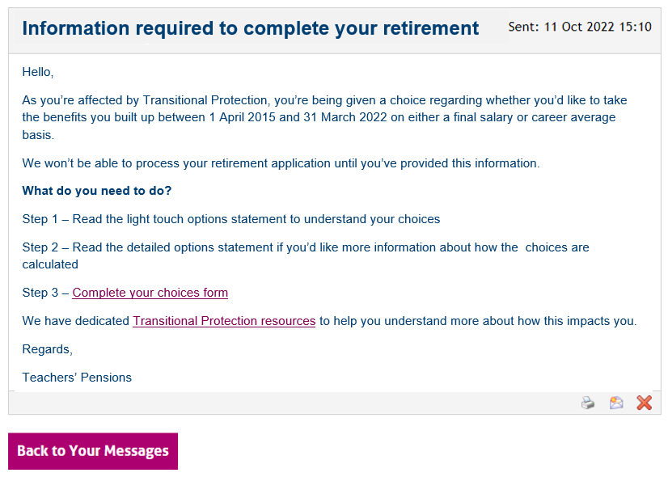
MPO inbox message
Attachment 1 – Light touch options statement
Attachment 2 – Detailed options statement

Slide 16
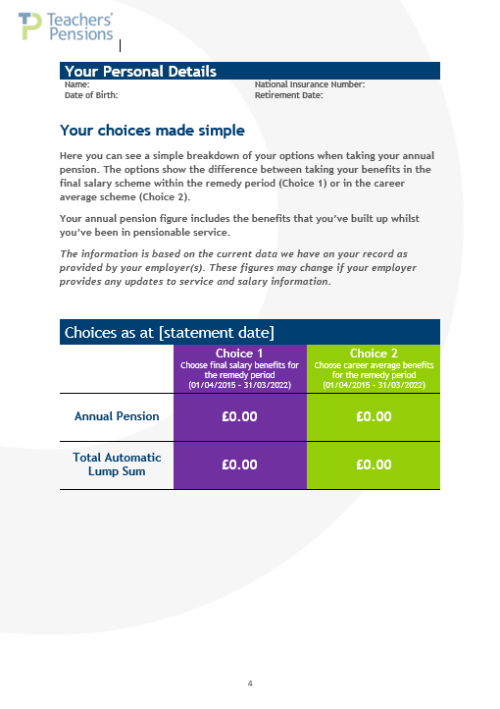
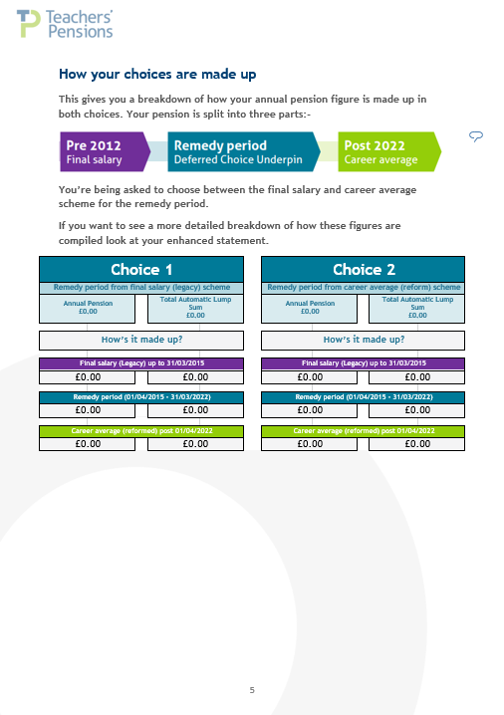
Light choice

Slide 17
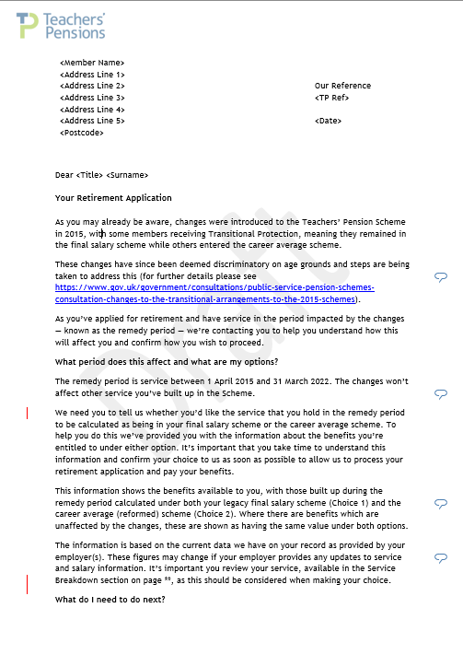
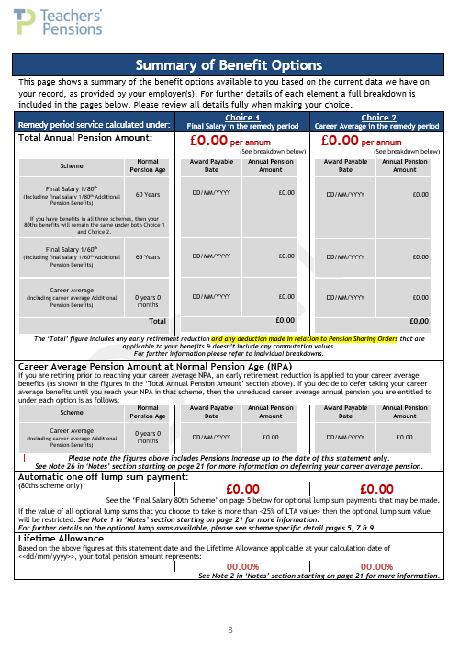
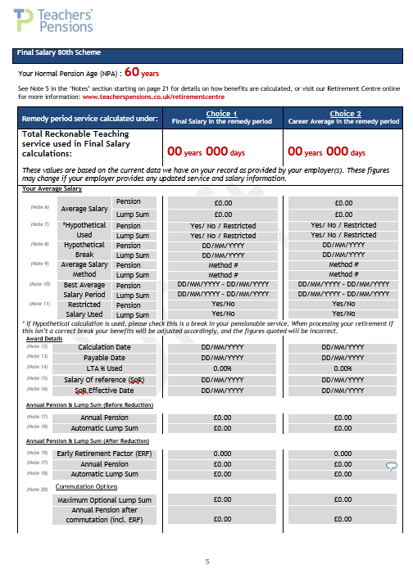
Detailed

Slide 18
Reminder process if no choice received
Automatic process
First reminder
Second reminder
Third reminder.

Slide 19
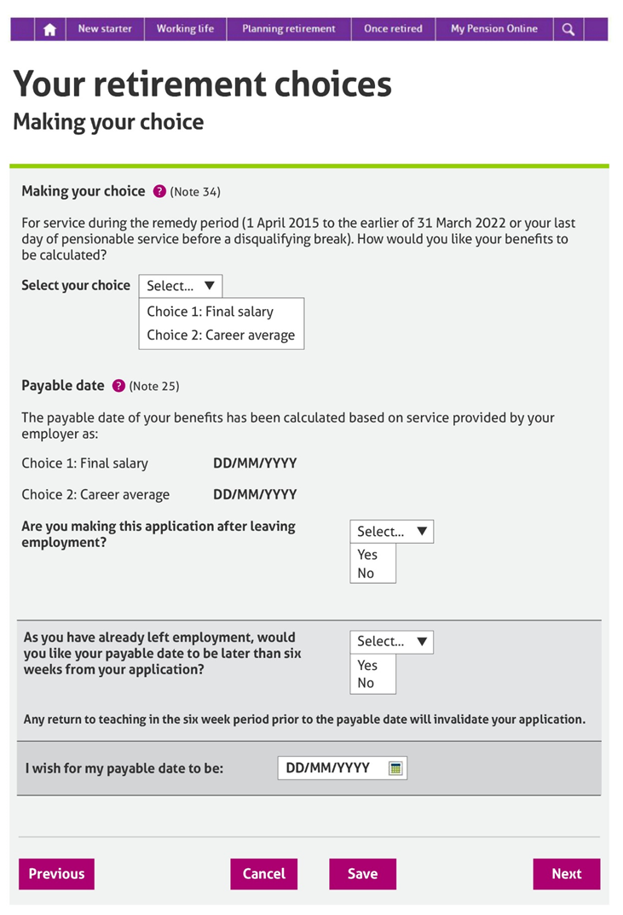
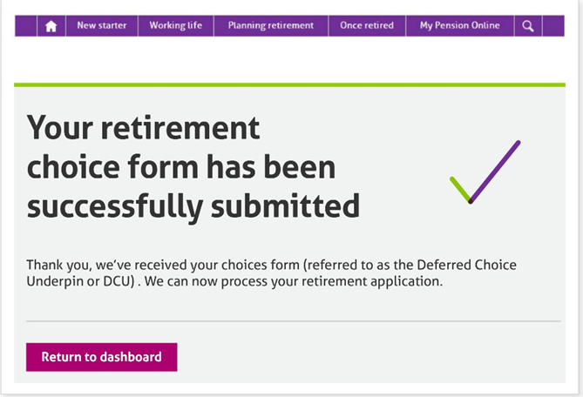
Options

Slide 20
Questions?

